Slide 1

FINANCE Department
QUARTERLY FINANCIAL REPORT
AS OF JUNE 30, 2026
ITEM # 14
SEPTEMBER 28, 2026
Presented by:
Kristine Horton
Finance Director

Slide 2

3RD QUARTER fye 2026 FINANCIAL REPORT
Property Tax Collections
Sales Tax
General Fund Revenues & Expenditures
Utility Fund Revenues & Expenditures
Capital Projects Funds
Investment Portfolio Update

Slide 3
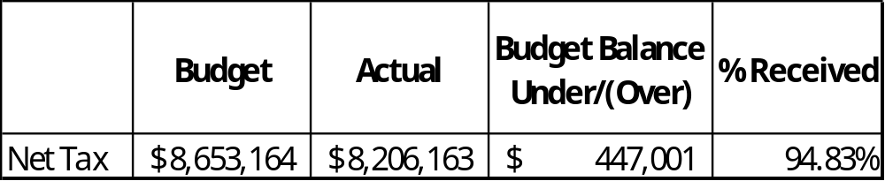
PROPERTY TAX COLLECTIONS M&o AND i&s

Slide 4
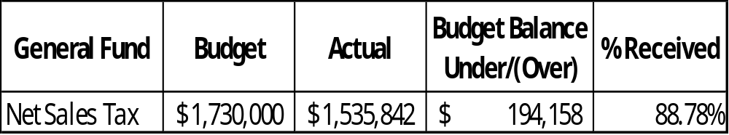
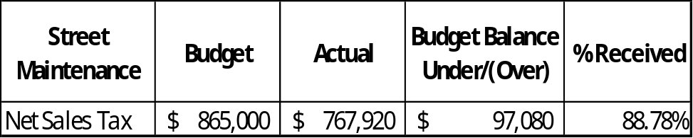
TOTAL SALES TAX REVENUE BY MONTH
Sales tax collections from the state are 2 months in arrears. YTD sales tax is $2,091,787 an increase of .02% compared to prior year 3rd Qtr. total of $2,091,364.

Slide 5
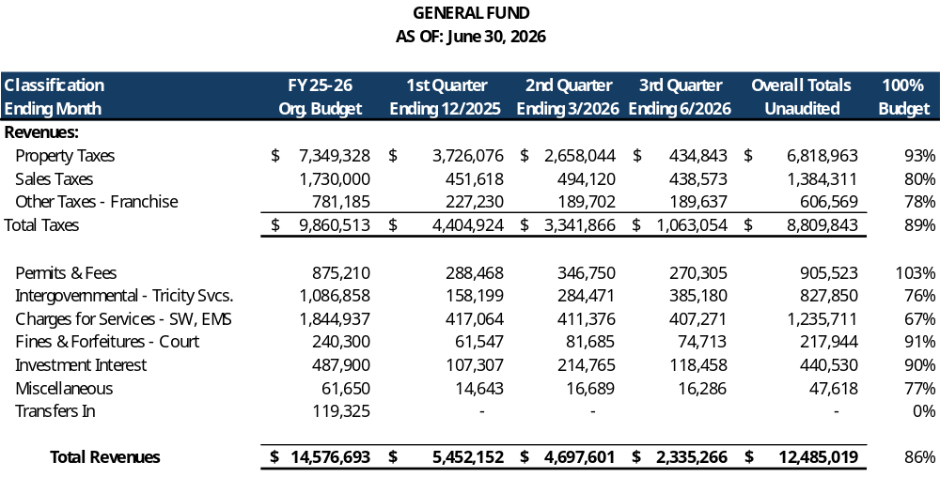
GENERAL FUND REVENUES
Notes:
Test

Slide 6
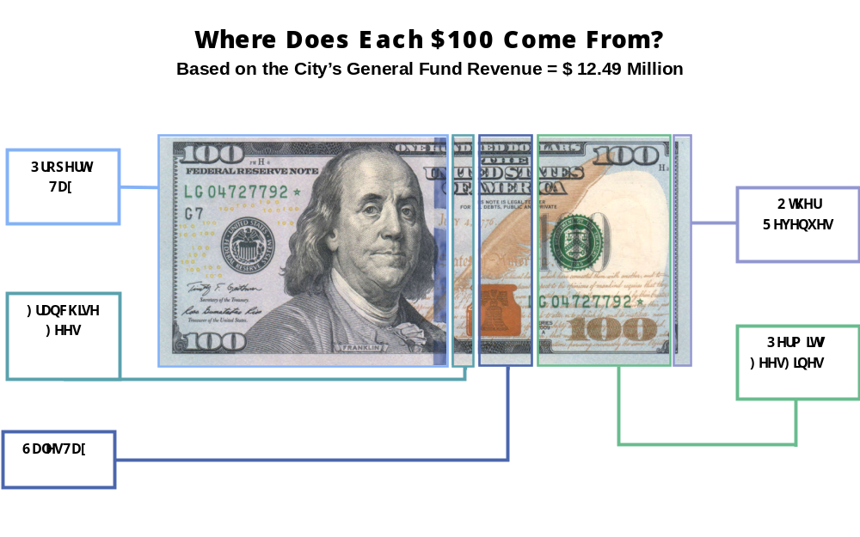
GENERAL FUND Revenue Tax Dollars

Slide 7
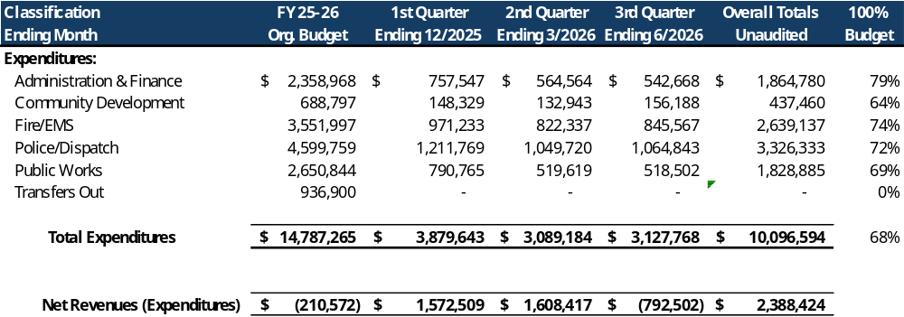
GENERAL FUND EXPENDITURE

Slide 8
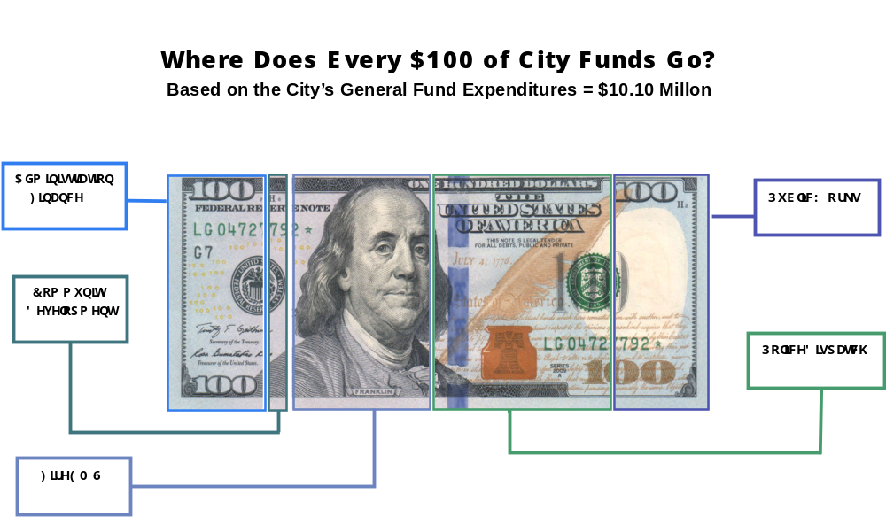
GENERAL FUND Tax Dollars at work

Slide 9
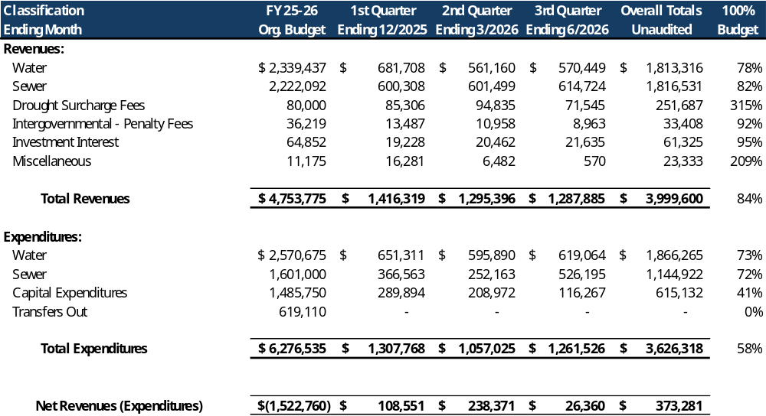
UTILITY FUND REVENUES & EXPENSES

Slide 10
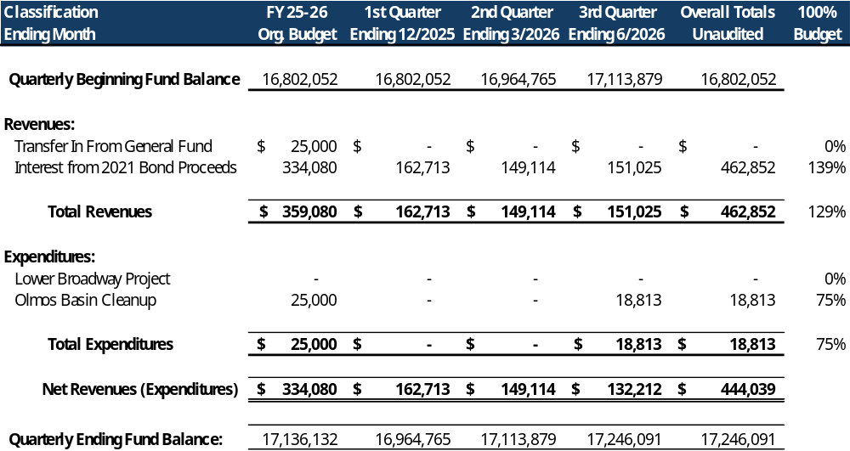
Capital projects fund

Slide 11
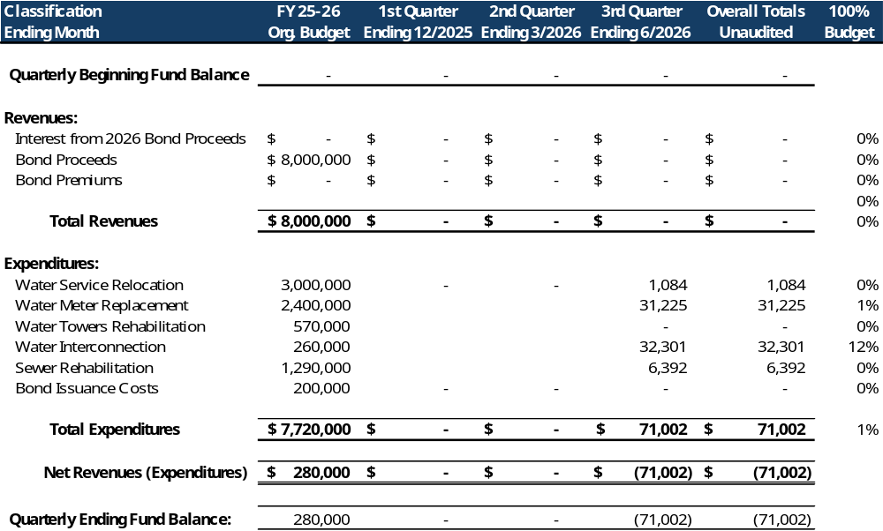
2026 Bond Capital Projects fund

Slide 12
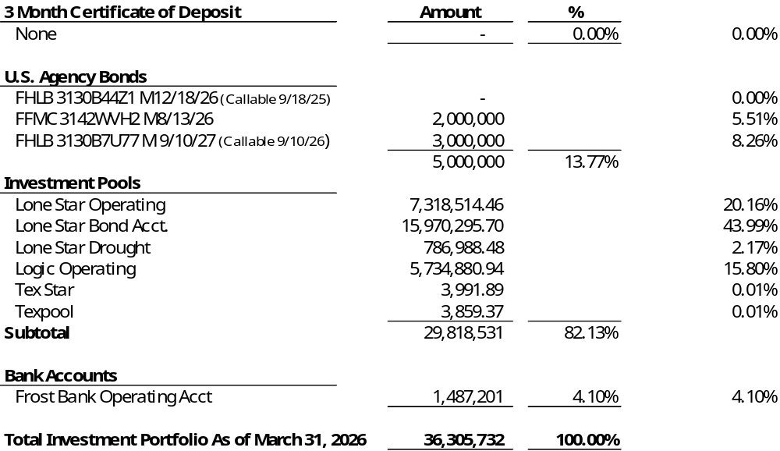
Investment portfolio update

Slide 13
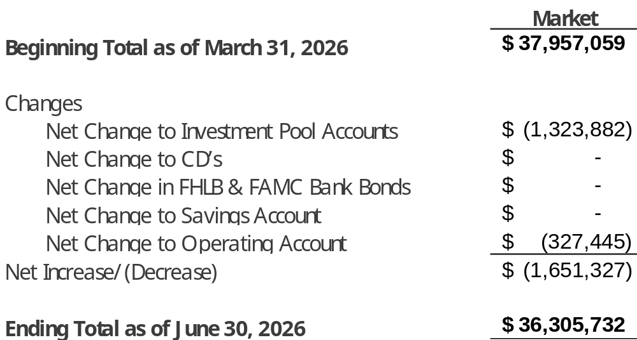
INVESTMENT PORTFOLIO CONTINUED
*
*
* The decrease in the Operating Bank Account and Investment Pool balances is primarily attributable to the payments of pay app 2, 3, & 4 for the pool park totaling 1,221,784

Slide 14
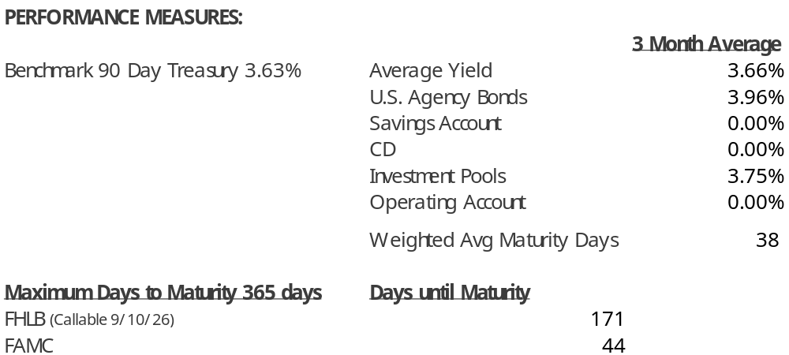
Investment portfolio continued

