Slide 1
community development
BOARD OF ADJUSTMENT
CASE NO. 2409
400 abiso ave
Presented by:
Lety Hernandez
Director

Slide 2
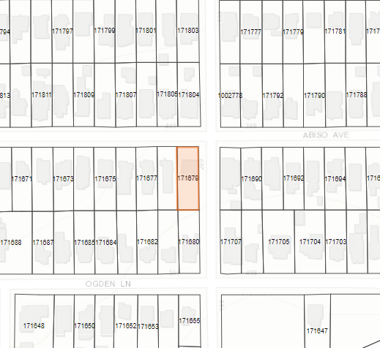
Property
SF-A
South side of Abiso Ave at intersection of Imlay St
Accessory Structure (Sauna)

Slide 3
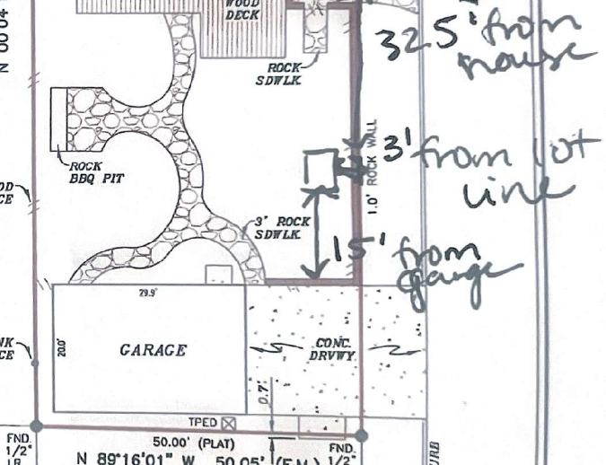
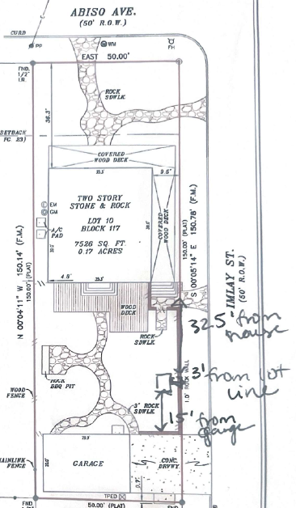
PROPOSED
Lot Coverage = 37.3%
FAR = .53

Slide 4
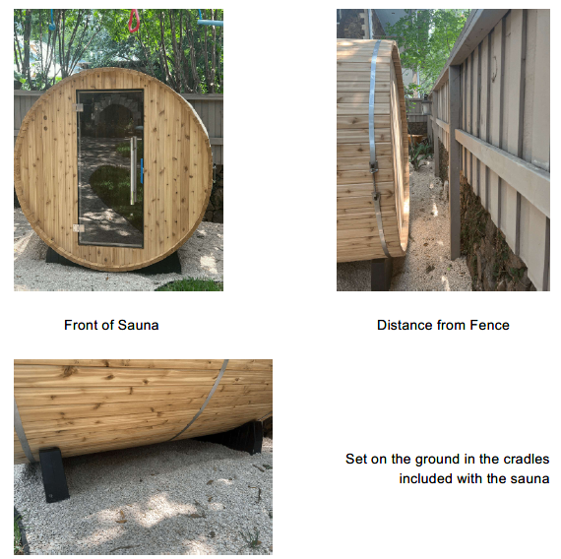
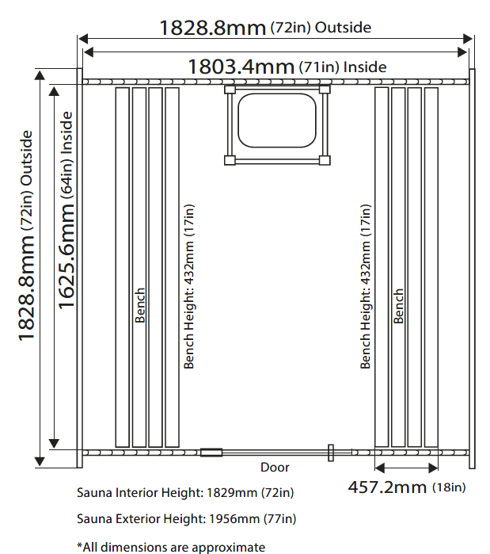
proposed

Slide 5
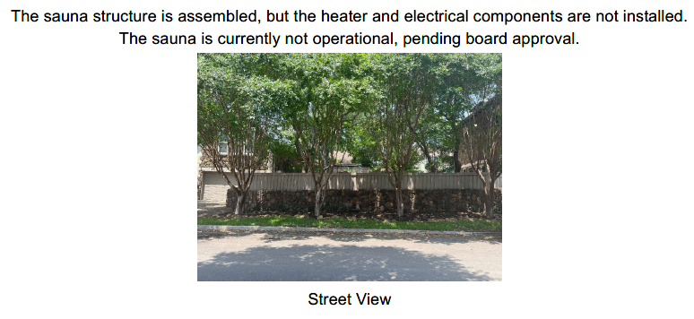
view from imlay st

Slide 6
p0licy analysis
Hardships
None.
Considerations
The proposed is subject to a permit and variance due to the permanent heater and electrical components.

Slide 7
Public notification
Postcards - mailed to property owners within a 200-foot radius
Notices posted - City website and on property
Responses received within 200ft:
Support: (2) Opposed: (0) Neutral: (0)

Slide 8
community development
BOARD OF ADJUSTMENT
CASE NO. 2407
223 allen st
Presented by:
Lety Hernandez
Director

Slide 9
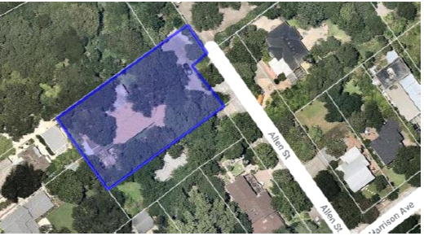
Property
SF-A
Southwest side of street
Accessory Structure (Planter Box)

Slide 10
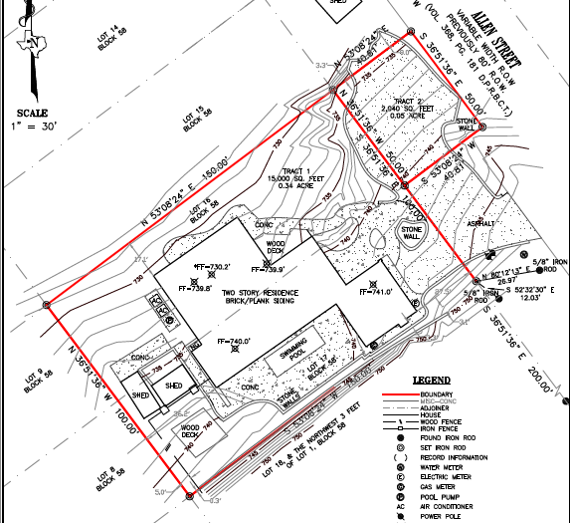
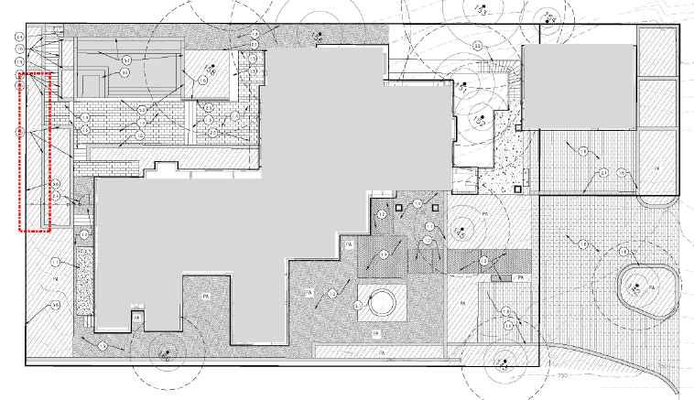
PREVIOUS & EXISTING SITE

Slide 11
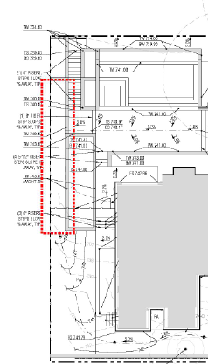
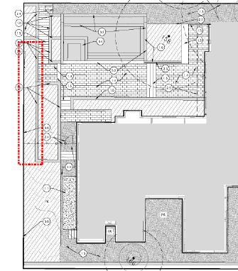
proposed east elevation

Slide 12
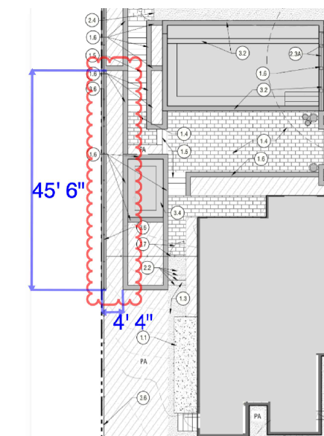
PROPOSED
OVERALL HEIGHT:
VARIES FROM 8 TO 5FT

Slide 13
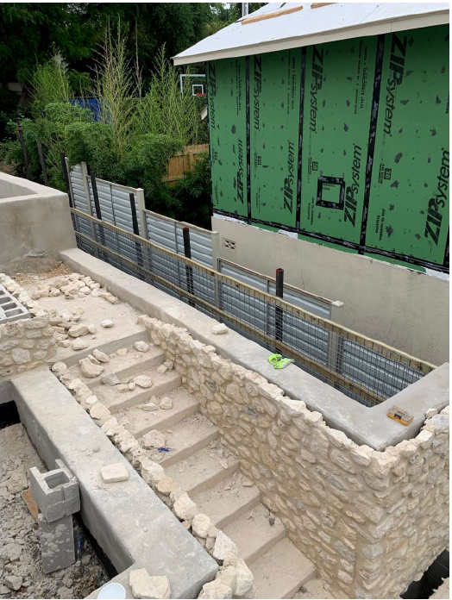
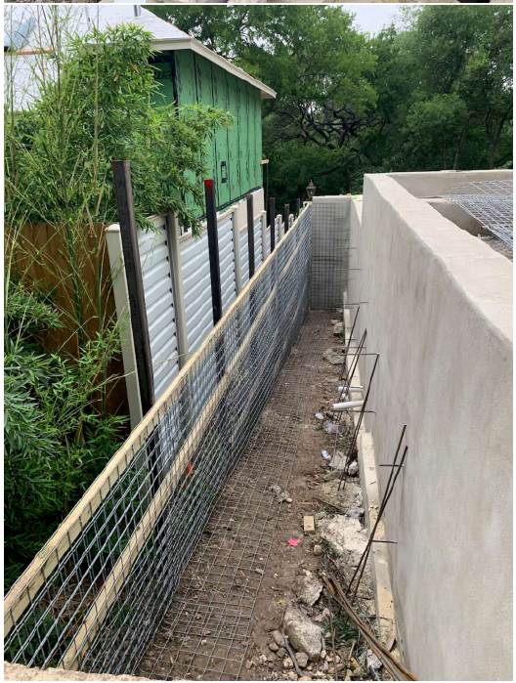
PROPOSED

Slide 14
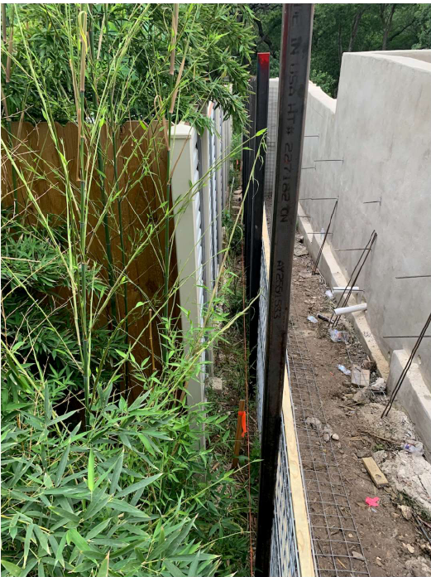
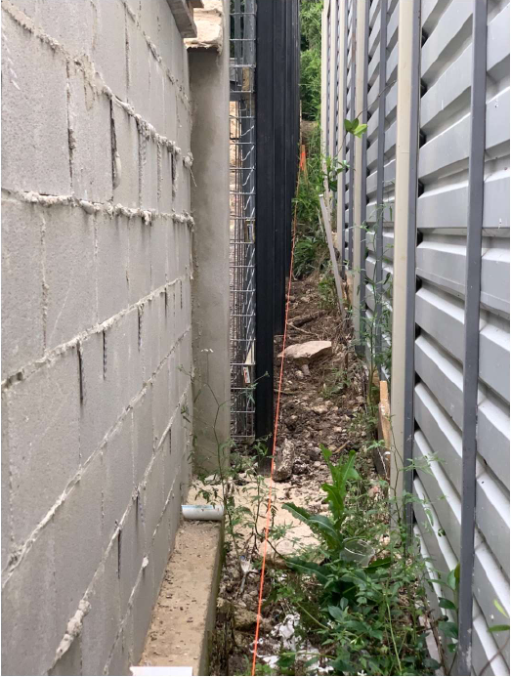
EXISTING VIEW

Slide 15
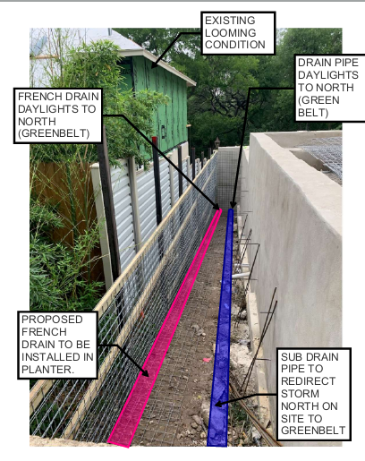
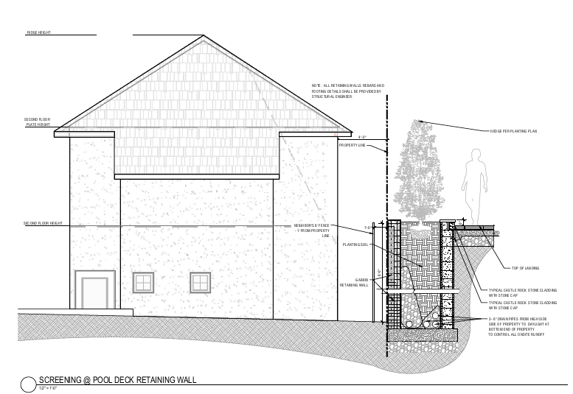
screening section

Slide 16
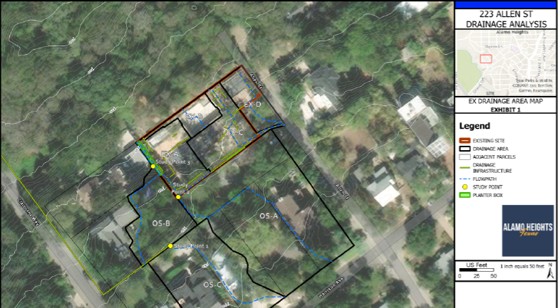
screening section

Slide 17
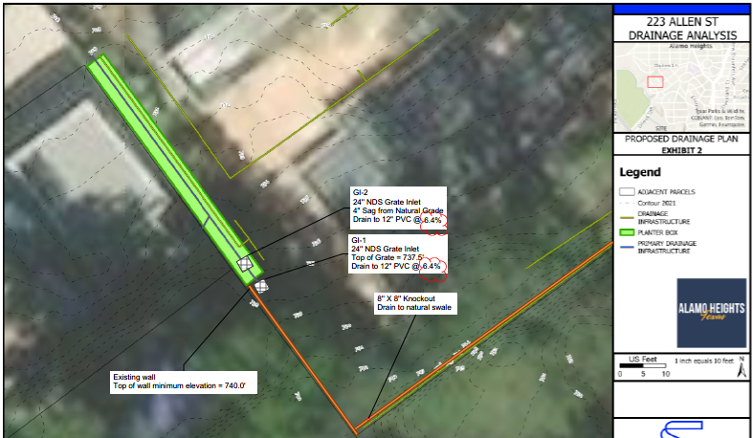
screening section

Slide 18
p0licy analysis
Hardships
Topography
Lot shape is irregular
Considerations
Zoning Code allows placement of an 8ft tall fence/wall at side and rear yard property lines, outside the front yard setback area.
Drainage plan was reviewed by the City’s engineer.

Slide 19
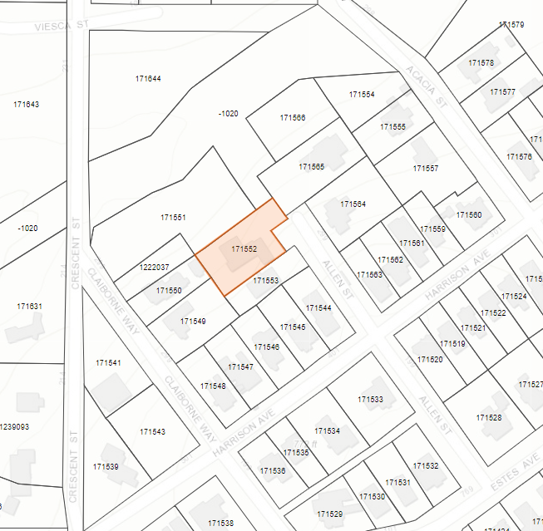
Public notification
Postcards - mailed to property owners within a 200-foot radius
Notices posted - City website and on property
Responses received within 200ft:
Support: (4) Opposed: (8) Neutral: (0)
Responses received outside 200ft:
Support: (23) Opposed: (4) Neutral: (0)

