Slide 1
community development
BOARD OF ADJUSTMENT
CASE NO. 2376
130 evans ave
Presented by:
Lety Hernandez
Director

Slide 2
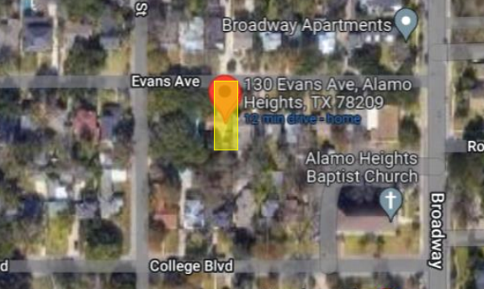
Property
SF-A
South side of street between Columbine St and Broadway St.
Replace off-street parking

Slide 3
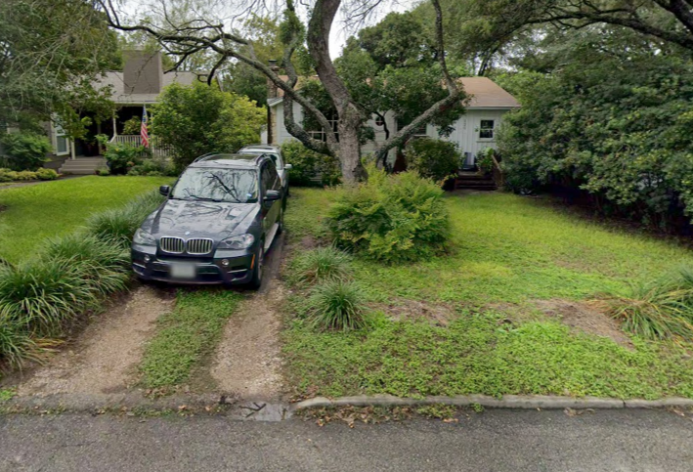
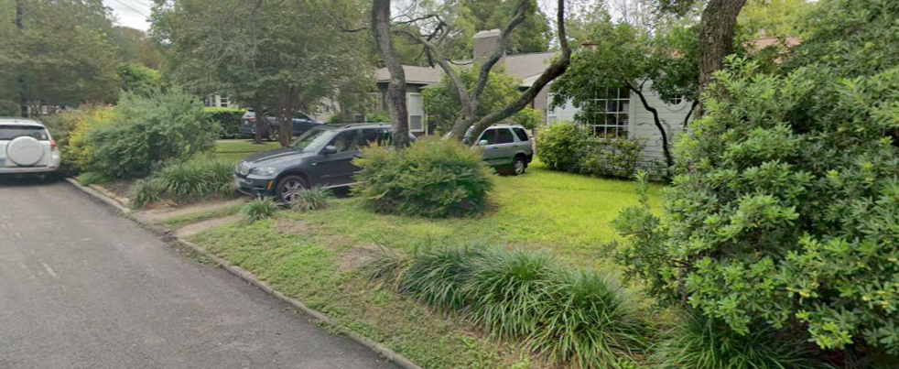
existing conditions

Slide 4
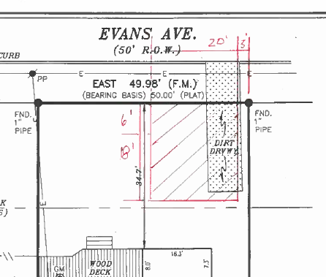
original proposal
20ft
24ft
Approach – 20ft width
Driveway – 24ft depth
Materials – Concrete
Total area – 600 sq ft
Total Front Yd SB – 480sq ft

Slide 5
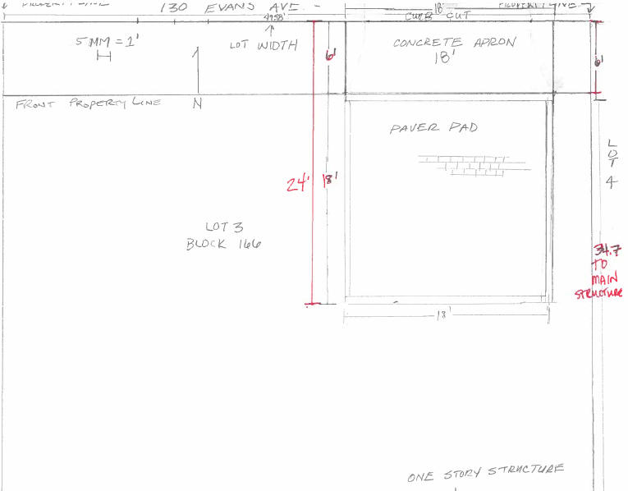
revised site plan
18ft
18ft
34ft from property line to main structure
Approach – 18ft width (Decrease to variance #5)
Driveway – 18ft depth (Decrease to variance #4)
Materials – Pavers
Total Area – 432 sq ft
Total Front Yd SB – 324sq ft
Impervious Coverage – 21.6% (Eliminates variance #1)

Slide 6
p0licy analysis
Hardships
None identified concerning lot size, lot shape, or topography.
Considerations
Preservation of the existing non-conforming main structure limits placement of improvements.
Tandem parking, currently, due to the current front yard setback to the main structure of 34.7ft.
Overall size of the parking area decreased.
Notes:
Re: preservation - Variances #2 & 3 could only be addressed with substantial and/or full demolition of the existing main structure.
Tandem Parking – Does not meet code requirement for parking size – Minimum 36ft.
Re: Decrease of Area - Results in the elimination one (1) variance (#1) and decreases requested non-conformity an additional two (2)(#4 & 5) of the original request.

Slide 7
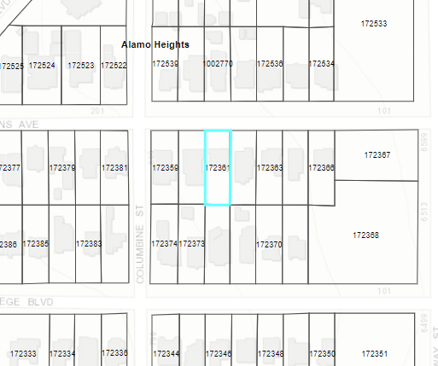
Public notification
Postcards - mailed to property owners within a 200-foot radius
Notices posted - City website and on property
Responses received:
Support: (6) Neutral: (0)
Oppose: (0)

Slide 8
community development
BOARD OF ADJUSTMENT
CASE NO. 2382
200 Westover rd
Presented by:
Lety Hernandez
Director

Slide 9
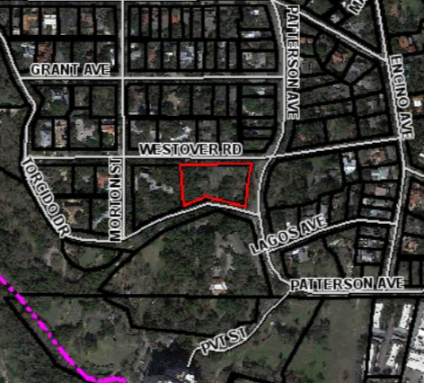
Property
SF-A
South side of Westover Rd at the intersection of Patterson Ave
Addition to Accessory Structure

Slide 10
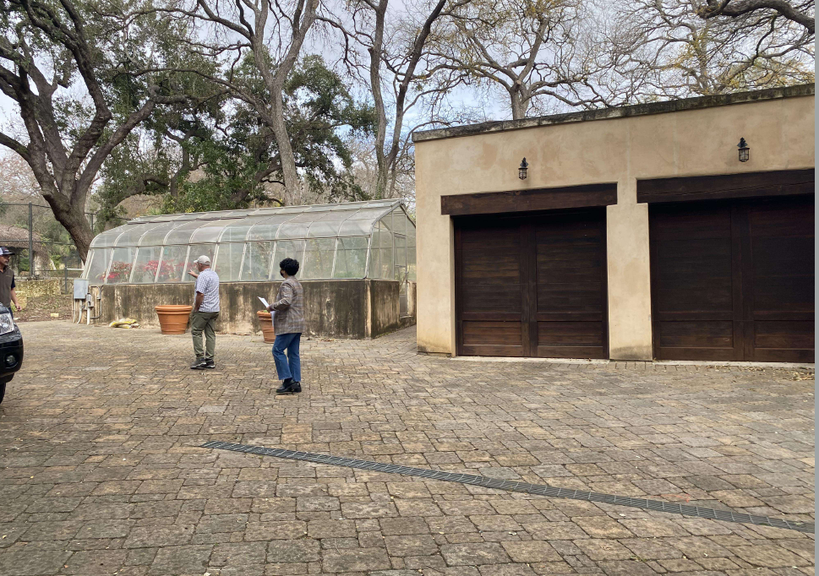
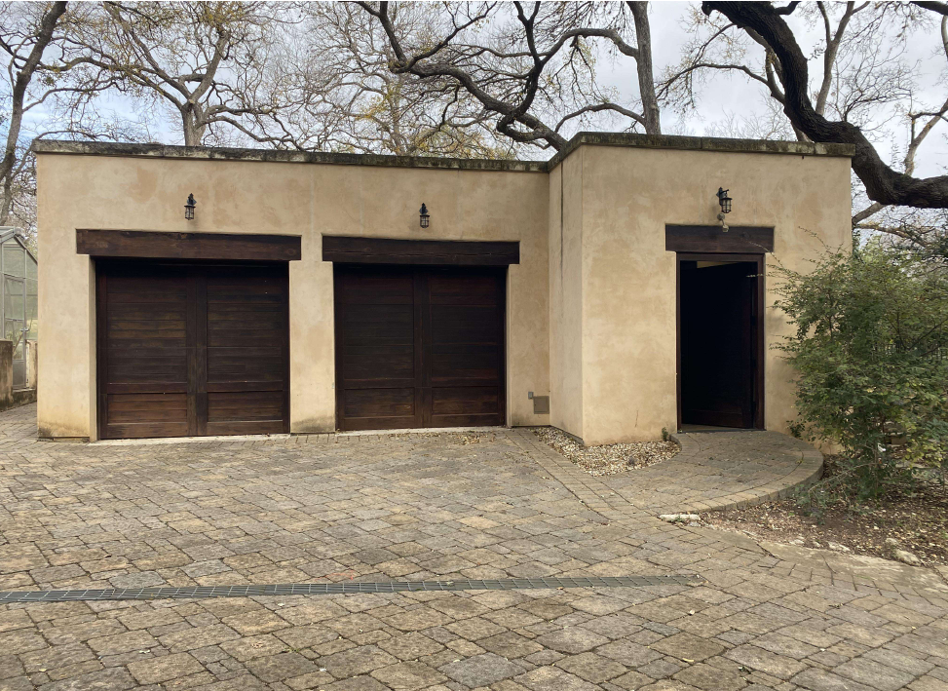
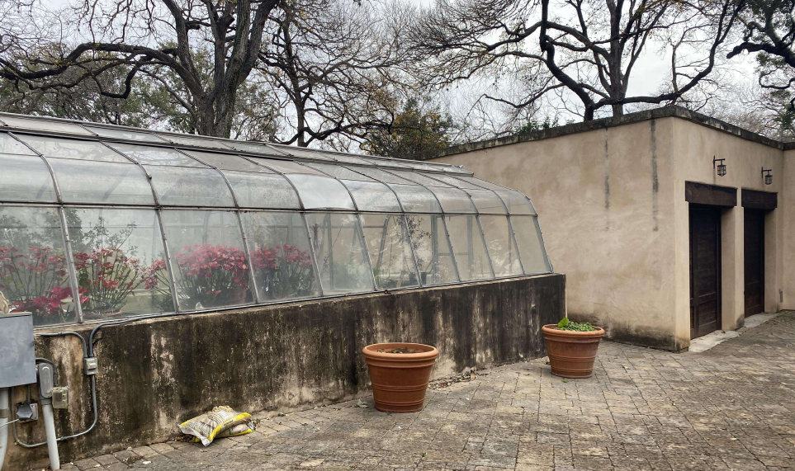
existing conditions

Slide 11
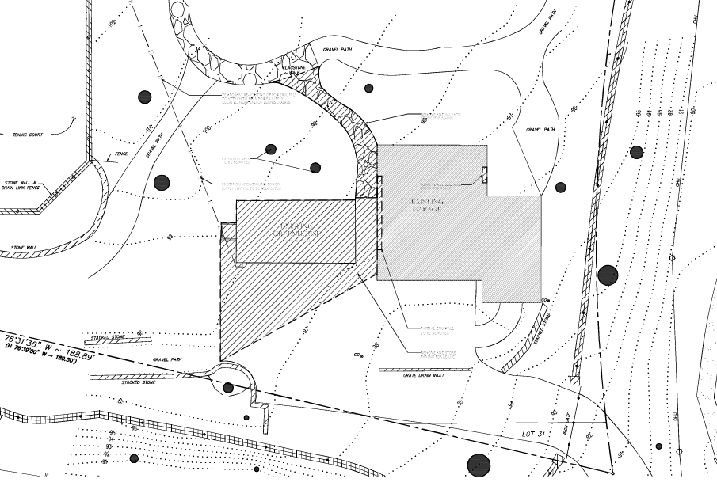
existing site plan

Slide 12
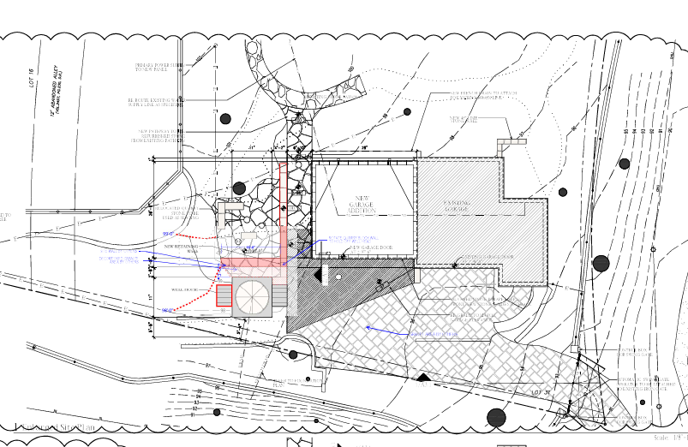
proposed site plan

Slide 13
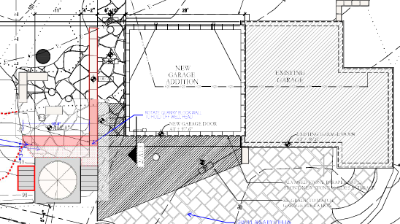
proposed site plan

Slide 14
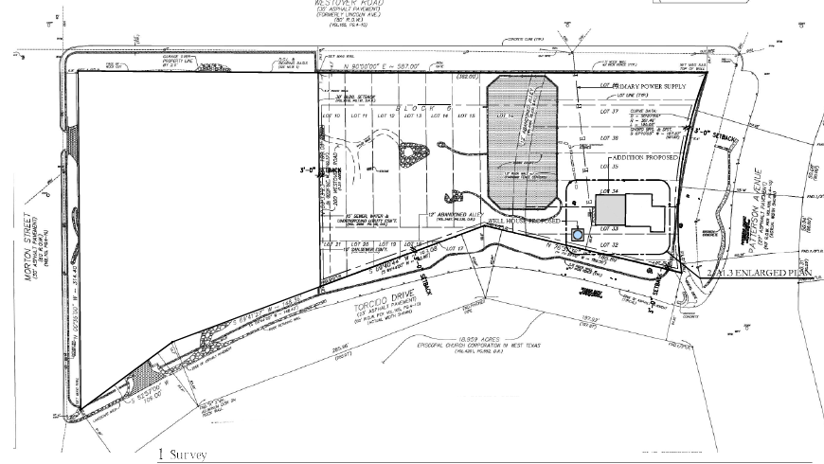
site plan
112 Torcido Dr
200 Westover Rd

Slide 15
p0licy analysis
Hardships
None identified concerning lot size, lot shape, or topography.
Considerations
The property has an existing accessory structure and a tennis court.
Owner has historically used the property as the rear yard to the adjoining 112 Torcido Dr.
Applicant has not formally submitted for plan review. Additional variances discovered during the review process, the applicant would be required to return before the board or revise proposed to comply with current regulations.

Slide 16
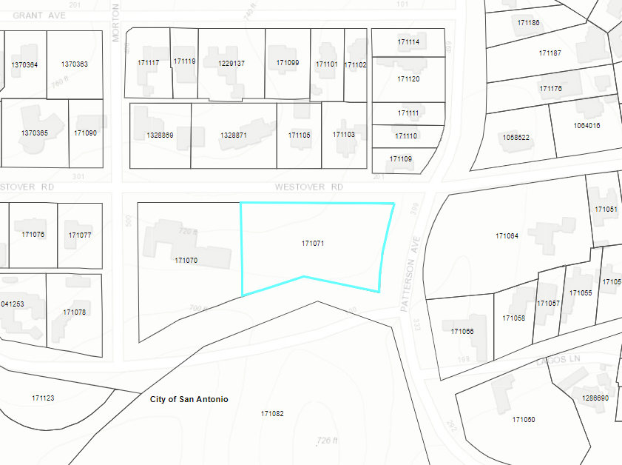
Public notification
Postcards - mailed to property owners within a 200-foot radius
Notices posted - City website and on property
Responses received:
Support: (1) Neutral: (0)
Oppose: (1)

Slide 17
community development
BOARD OF ADJUSTMENT
CASE NO. 2383
259 Montclair st
Presented by:
Lety Hernandez
Director

Slide 18
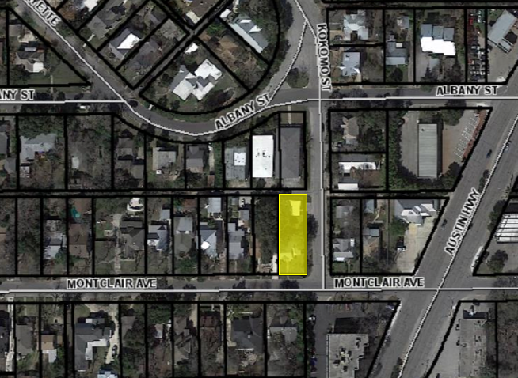
Property
2F-C
Northern corner of Montclair at Kokomo St
Circular Driveway

Slide 19
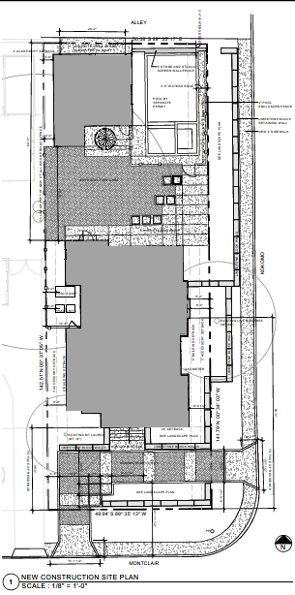
proposed site plan
N

Slide 20
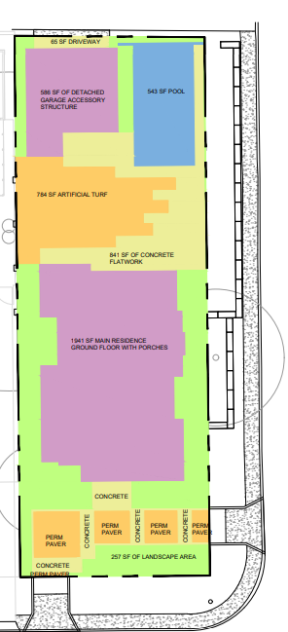
proposed conditions

Slide 21
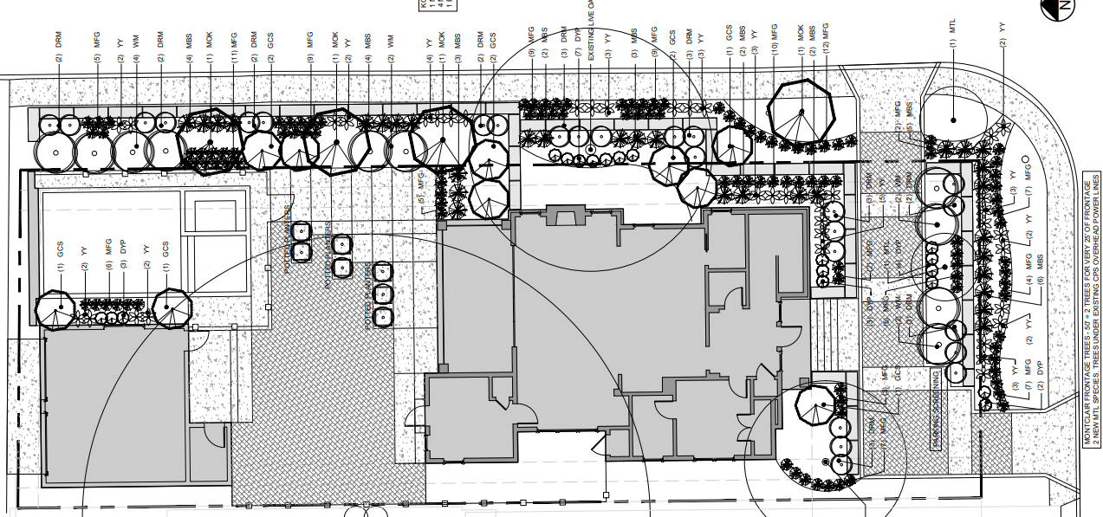
proposed site plan
Size: 10ft by 10ft (100sq ft)
Top of Plate from FF: 7ft 6-½ inches
Top of Shed Roof from FF: 11ft 6-½ inches

Slide 22
p0licy analysis
Hardships
None identified concerning lot size, lot shape, or topography.
Considerations
Improvements in conjunction with new construction that will provide rear access to covered parking.
Proposed landscaping would minimize view of flatwork.
Plan review process has not been completed. If additional variances are discovered, applicant would need to return before the board or revise the proposed to comply with current regulations.

Slide 23
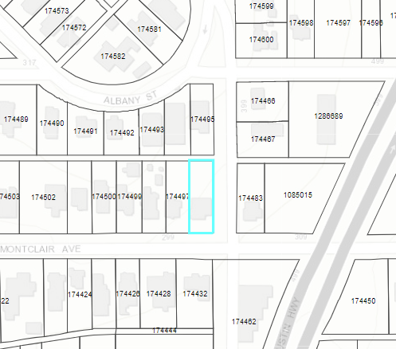
Public notification
Postcards - mailed to property owners within a 200-foot radius
Notices posted - City website and on property
Responses received:
Support: (3) Neutral: (0)
Oppose: (0)

