Slide 1

Community development
P&Z Case no. 456/457
401 harrison ave & 213 allen st
march 02, 2026
Presented by:
Tyler Brewer
Senior Planner

Slide 2
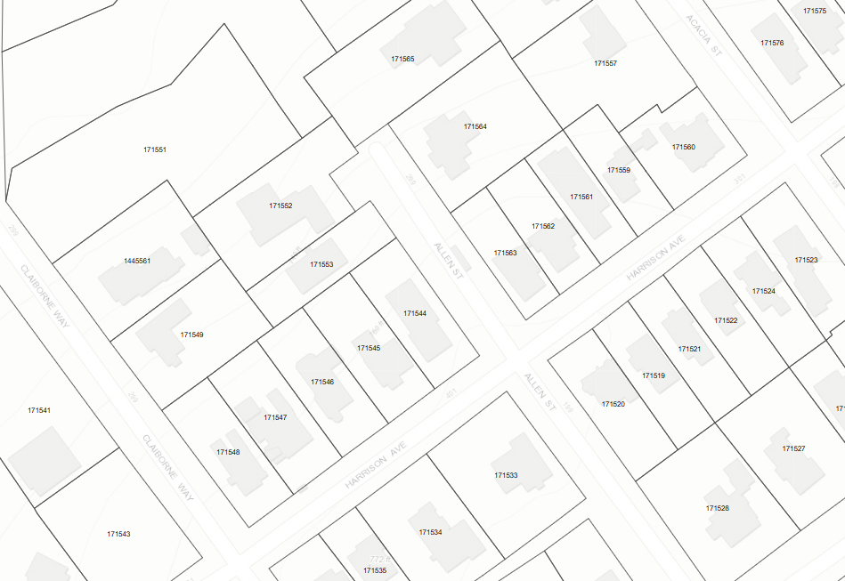
property
SF-A
Western side of Allen St, north of Harrison Ave
Requesting purchase of ROW
401 Harrison Ave
213 Allen St

Slide 3
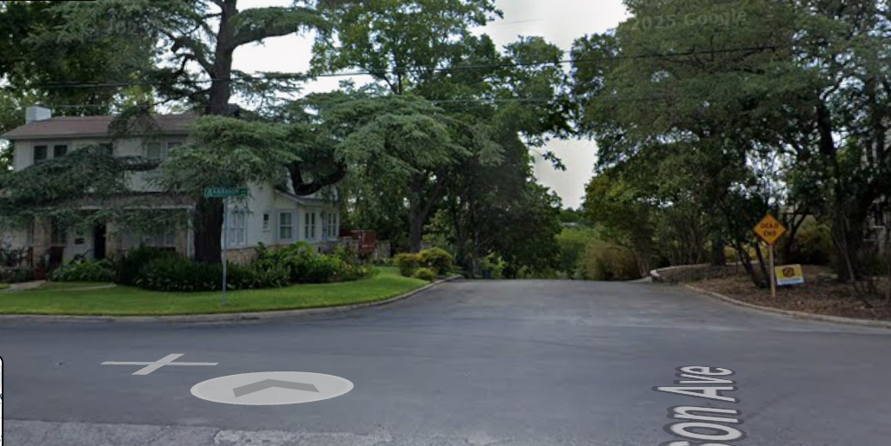
Property – view from harrison ave

Slide 4
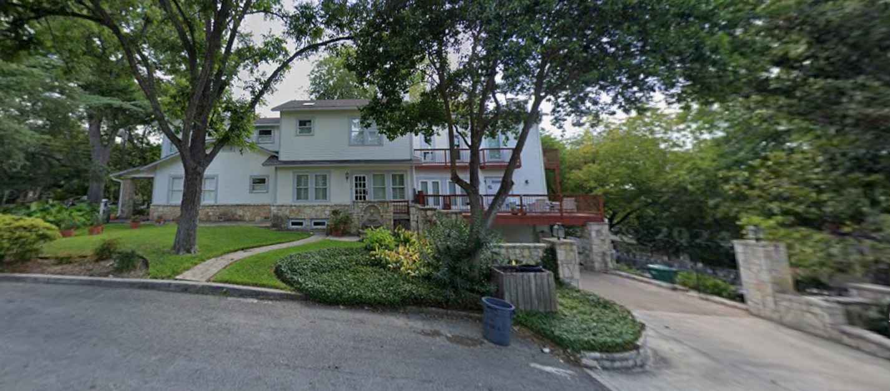
Property – view from allen st

Slide 5
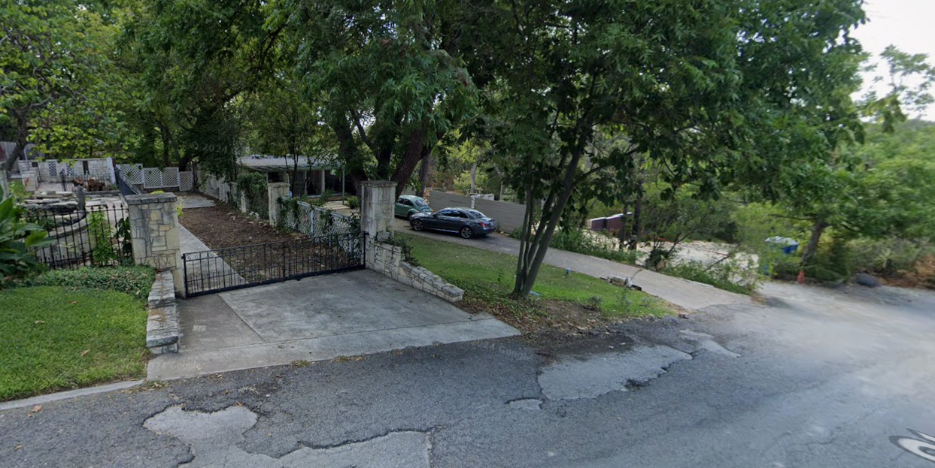
Property – view from allen st

Slide 6
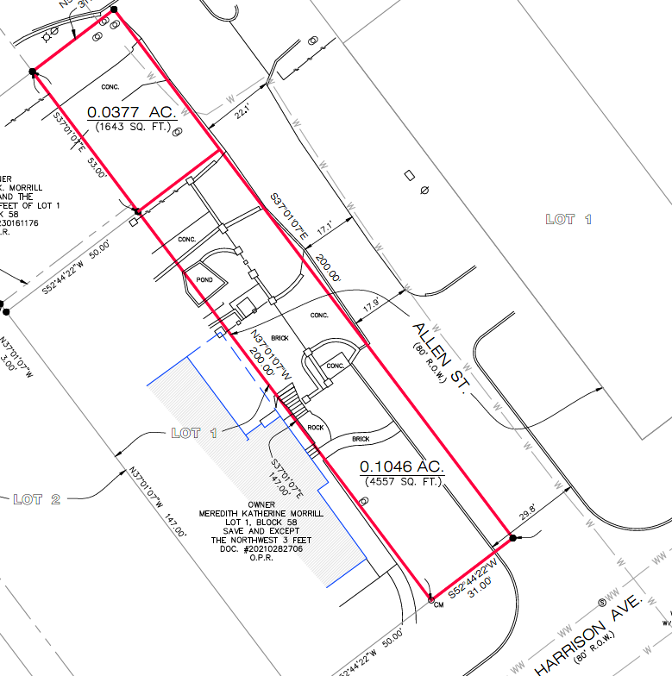
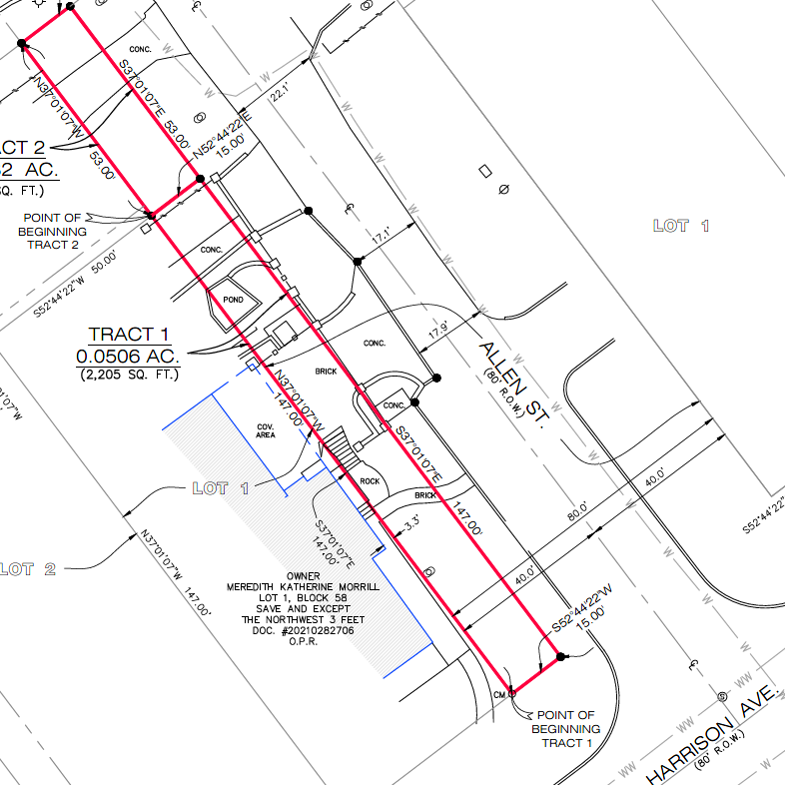
Original vs. revised proposal

Slide 7
Policy analysis - Update
Current structure located at 401 Harrison Ave encroaches in ROW. Area limited to repairs only.
Final survey of the requested areas is required. - Provided
Proposal reduces portion of street’s width from almost 30 ft to 18 ft – New proposal no longer reduces street width
Removes approx. 12 ft width of improved street for first 100 ft (approx.) of dead-end street – N/A
Public Works & Fire Departments oppose the request due to the impact on ability to provide sanitation and emergency services. – PW no longer opposes request; FD pending response
Fire Apparatus Access Road – 20 ft minimum width (per Fire Code)
Ladder truck needs minimum of 26 ft to operate
Fire apparatus & sanitation vehicles must back out with existing street conditions

Slide 8
Policy analysis - update
Sect. 16-101: General Provisions
(g) Fair market value – Option to rely on an average price per square foot per BCAD market values or require an independent professional appraisal by a jointly selected appraiser.
Price per square foot per BCAD market values option
4557 2205 sq ft at $46.57 per sq ft = $212,219.49 $102,686.85
1643 795 sq ft at $46.57 per sq ft = $76,514.51 $37,023.15
Notes:
Applicant has not confirmed which option they will select.

Slide 9
Policy analysis
Sect. 16-105(d): Closure, vacation & abandonment of ROW
Consideration and recommendation by the Planning and Zoning Commission to City Council is required
To be considered at the regular City Council meeting of March 23, 2026 pending recommendation.

Slide 10
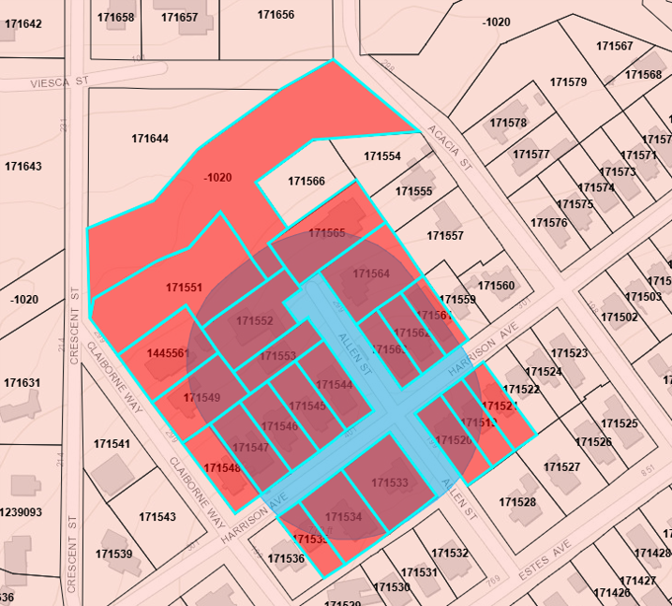
Public notification – 401 harrison
Postcards – mailed to property owners within a 200-foot radius
Notices – posted on City website and on the properties
Legal Notice – posted in official newspaper of the City (SA Express News)
Responses received (Inside 200-ft radius):
Support: (0) Opposed: (0) Neutral: (0)
Responses received (Outside 200-ft radius):
Support: (0) Opposed: (0) Neutral: (0)

Slide 11
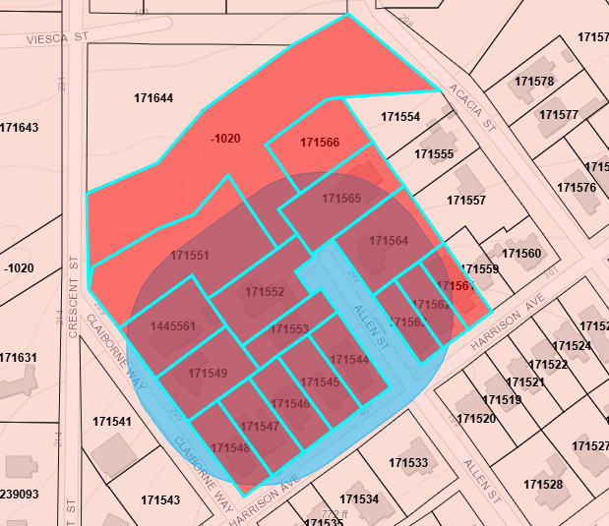
Public notification – 213 allen st
Postcards – mailed to property owners within a 200-foot radius
Notices – posted on City website and on the properties
Legal Notice – posted in official newspaper of the City (SA Express News)
Responses received (Inside 200-ft radius):
Support: (0) Opposed: (0) Neutral: (0)
Responses received (Outside 200-ft radius):
Support: (0) Opposed: (0) Neutral: (0)

Slide 12
Community development
P&Z Case nos. 462
6715 broadway st
January 05, 2026
Presented by:
Tyler Brewer
Senior Planner

Slide 13
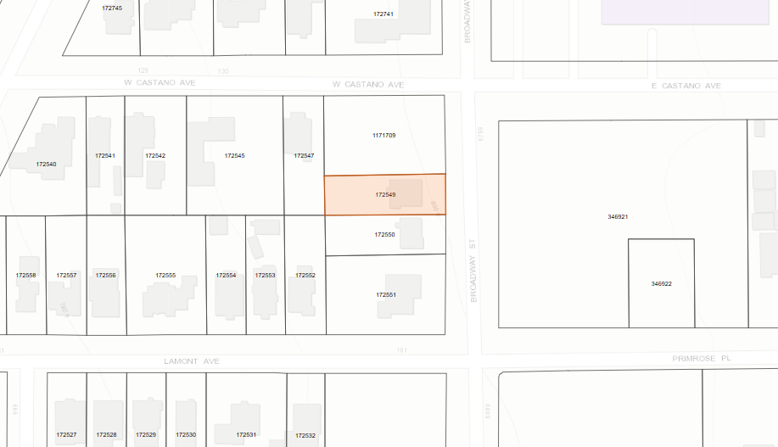
summary
Multi-Family District (MF-D)
West side of Broadway St in between W Castano Ave and Lamont Ave
Rezone

Slide 14
summary
Proposal to rezone from Multi-Family District (MF-D) to Office District (O-1)

Slide 15
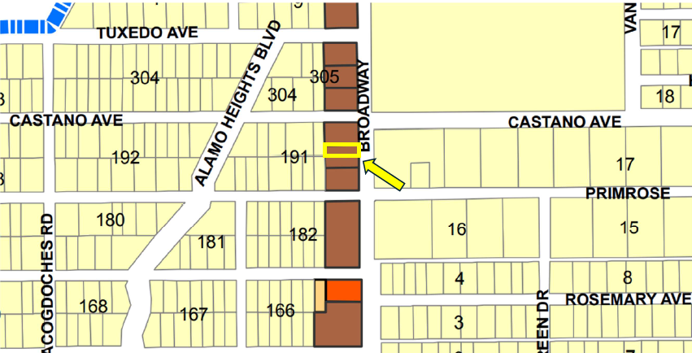
property

Slide 16
Policy analysis
There are a total of seven (7) properties within the city limits zoned Office District (O-1) and serve as a buffer between residential and commercial zoned properties.
Allows for single/multi-family dwellings and limited commercial uses

Slide 17
Policy analysis
Any proposed improvements subject to plan review to ensure compliance with current codes.
Final Review by the Architectural Review Board and approval by City Council to be determined at time of permit request.
To be considered at the regular City Council meeting of March 23, 2026 pending recommendation.

Slide 18
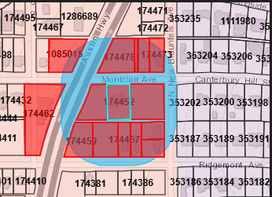
Public notification
Postcards – mailed to property owners within a 200-foot radius
Notices – posted on City website and on the properties
Legal Notice – posted in official newspaper of the City (SA Express News)
Responses received (Inside 200-ft radius):
Support: (0) Opposed: (0) Neutral: (0)
Responses received (Outside 200-ft radius):
Support: (0) Opposed: (0) Neutral: (0)

Slide 19
Community development
P&Z Case no. 459
6800 block of broadway st & 116 tuxedo ave (Rezone)
march 02, 2026
Presented by:
Tyler Brewer
Senior Planner

Slide 20
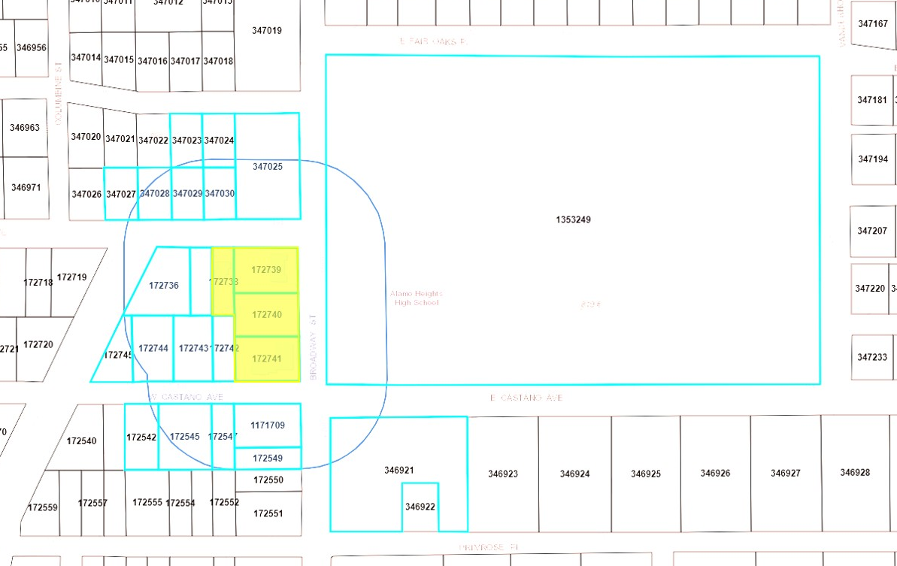
summary
Multi-Family District (MF-D) & Single-Family Dwelling District A (SF-A)
West side of Broadway St between W Castano Ave & Tuxedo Ave
Rezone

Slide 21
summary
Proposal to rezone from Multi-Family District (MF-D) & Single-Family Dwelling District A (SF-A) to Parking District (P) would allow applicant to provide parking for the AHISD High School and additional current/proposed buildings in the area

Slide 22
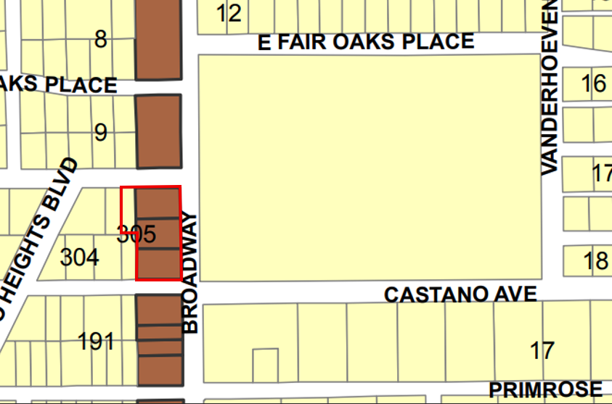
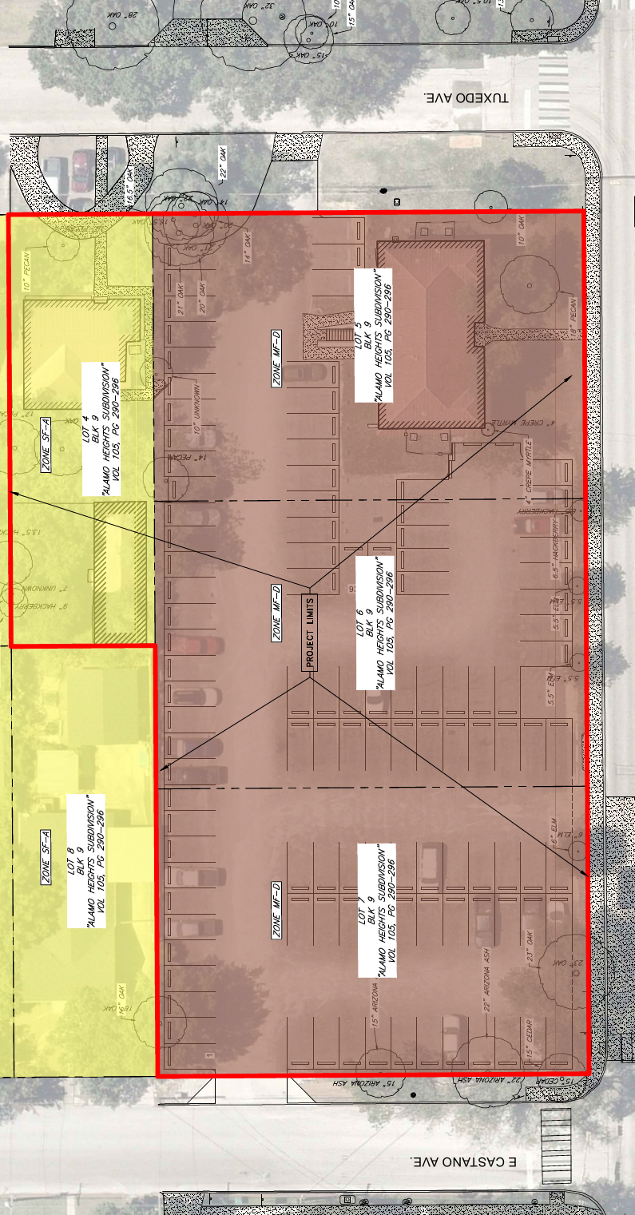
property

Slide 23
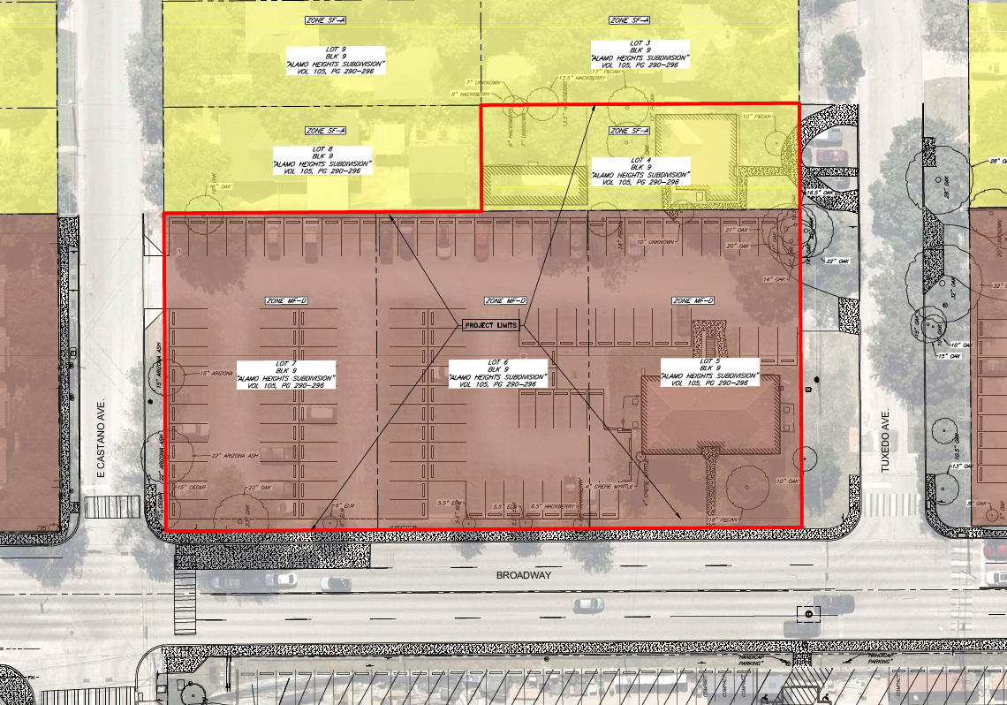
Current conditions

Slide 24
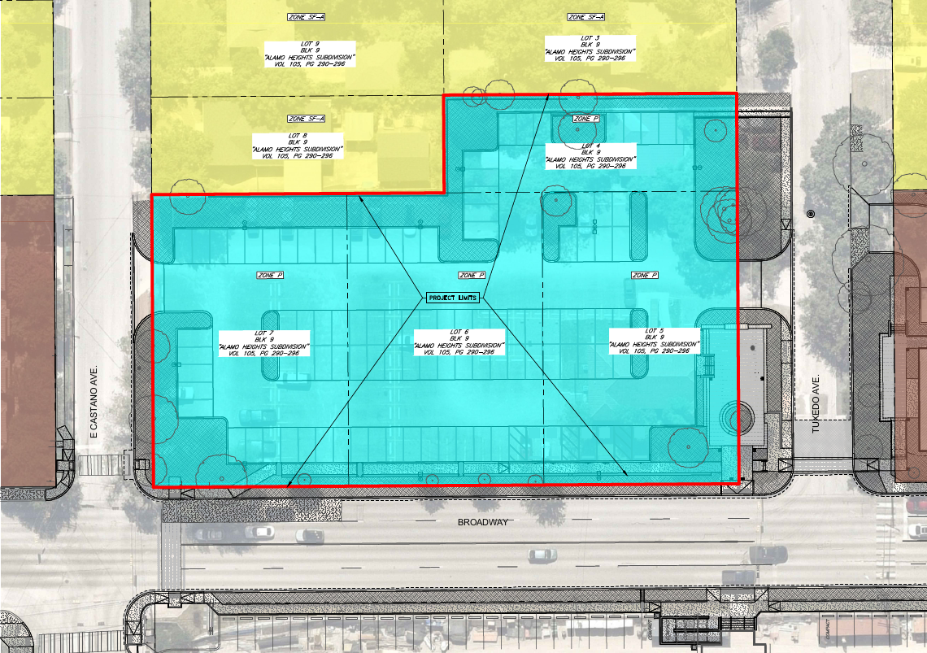
proposed conditions

Slide 25
Policy analysis
Parking District (P) serves to provide off-street parking of motor vehicles.
Improvements subject to plan review to ensure compliance with current codes.
To be considered at the regular City Council meeting on March 23, 2026, pending recommendation from P&Z.

Slide 26
Public notification
Postcards – mailed to property owners within a 200-foot radius
Notices – posted on City website and on the properties
Legal Notice – posted in official newspaper of the City (SA Express News)
Responses received (Inside 200-ft radius):
Support: (0) Opposed: (0) Neutral: (0)
Responses received (Outside 200-ft radius):
Support: (0) Opposed: (0) Neutral: (0)

Slide 27
Community development
P&Z Case no. 460
6800 block of broadway st & 116 tuxedo ave (replat)
march 02, 2026
Presented by:
Tyler Brewer
Senior Planner

Slide 28
property
Multi-Family District (MF-D) & Single-Family Dwelling District A (SF-A)
West side of Broadway St between W Castano Ave & Tuxedo Ave
Rezone

Slide 29
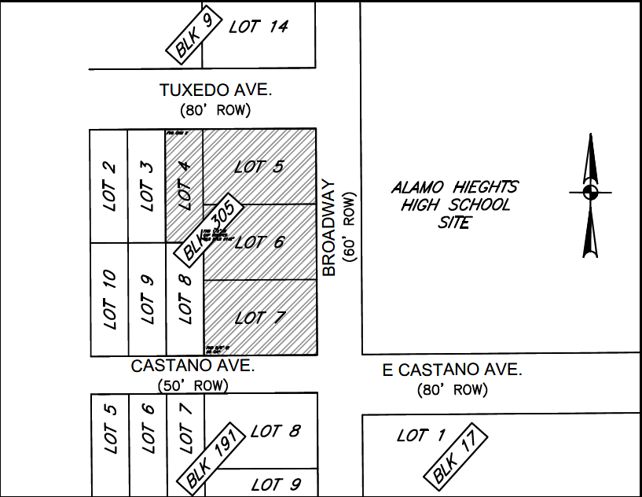
Existing conditions

Slide 30
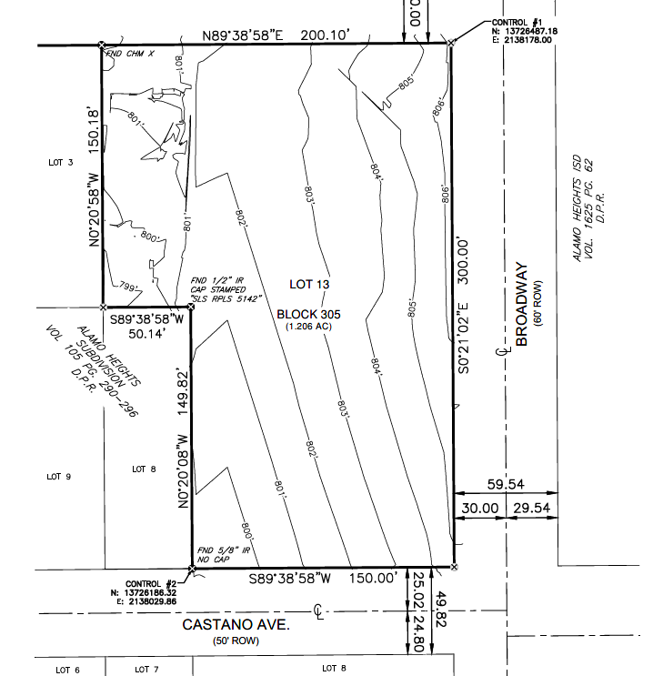
Proposed conditions

Slide 31
Policy analysis
Lot Area
No minimum lot area in P Zoning District
Lot Width
No minimum lot width in P Zoning District

Slide 32
Policy analysis
Approval by CPS, SAWS, & Public Works is required prior to release for recordation.
To be considered at the regular City Council meeting on March 23, 2026, pending recommendation from P&Z.

Slide 33
Public notification
Postcards – mailed to property owners within a 200-foot radius
Notices – posted on City website and on the properties
Legal Notice – posted in official newspaper of the City (SA Express News)
Responses received (Inside 200-ft radius):
Support: (0) Opposed: (0) Neutral: (0)
Responses received (Outside 200-ft radius):
Support: (0) Opposed: (0) Neutral: (0)

Slide 34
Community development
P&Z Case no. 461
AHISD SUP
march 02, 2026
Presented by:
Tyler Brewer
Senior Planner

Slide 35
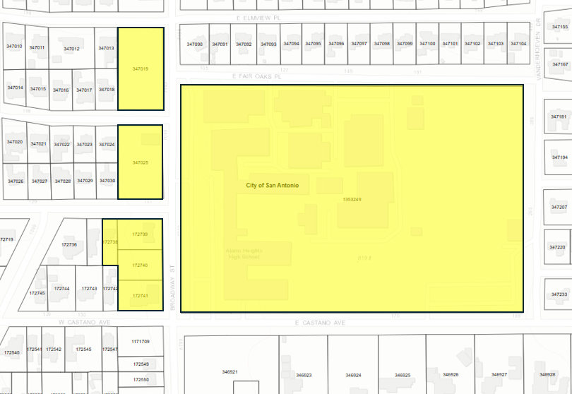
summary
Multi-Family District (MF-D) & Single-Family Dwelling District A (SF-A)
6900 Broadway St (AHISD High School Campus), the 6800 Block of Broadway St, 116 Tuxedo Ave, 7001 Broadway St, and 7101 Broadway St
SUP

Slide 36
summary
Proposal to replace the existing SUPs previously approved for 6900 Broadway St with a new SUP that consolidates those ordinances into one and expands the scope of the ordinance to include the other AHISD properties on the west side of Broadway St between Castano Ave and E Elmview Pl.
Variances to City’s Zoning Code requested through SUP
Discussion and feedback only

Slide 37
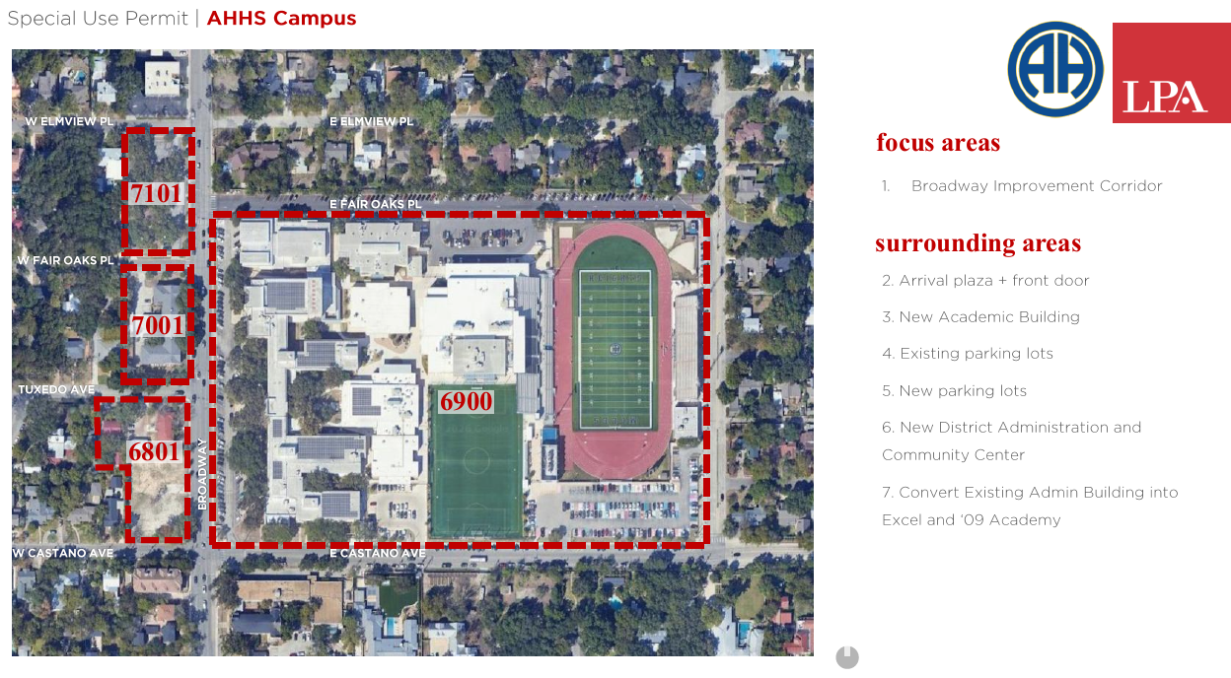
Proposal - Overview

Slide 38
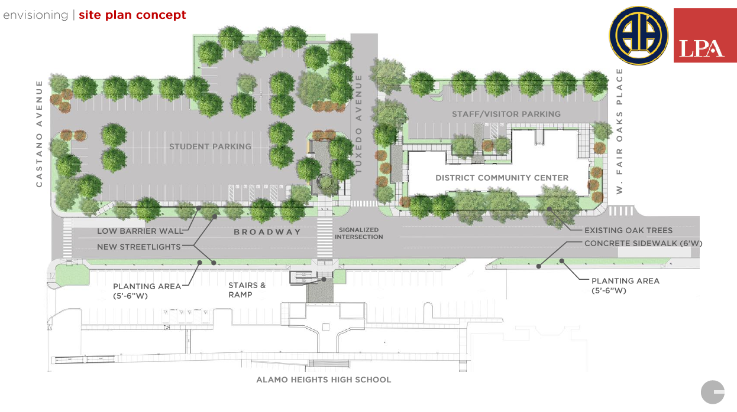
Proposal – Concept Plan

Slide 39
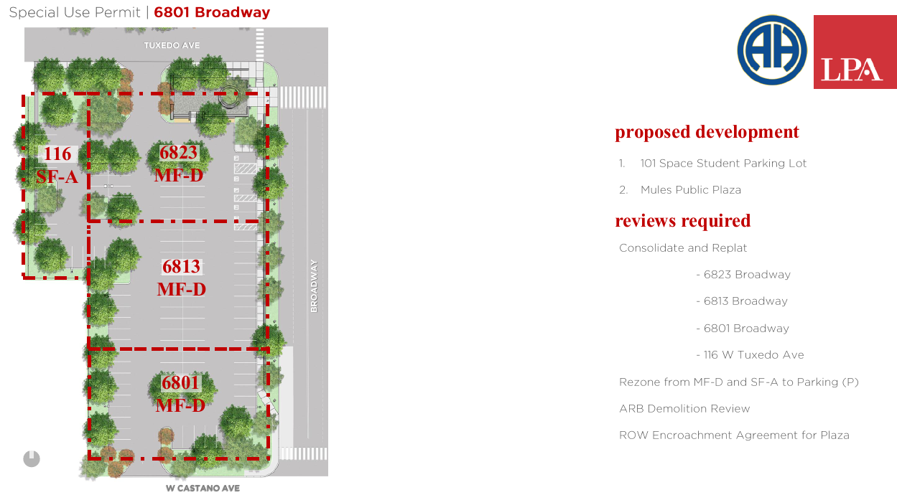
Proposal – 6800 Block of Broadway/116 Tuxedo

Slide 40
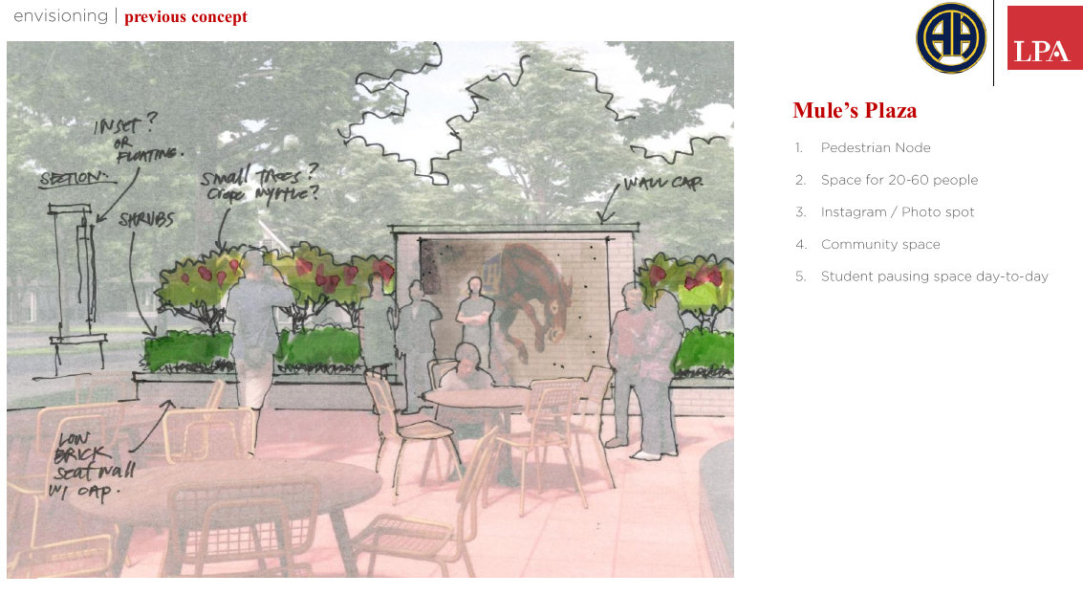
Proposal – 6800 Block of Broadway/116 Tuxedo

Slide 41
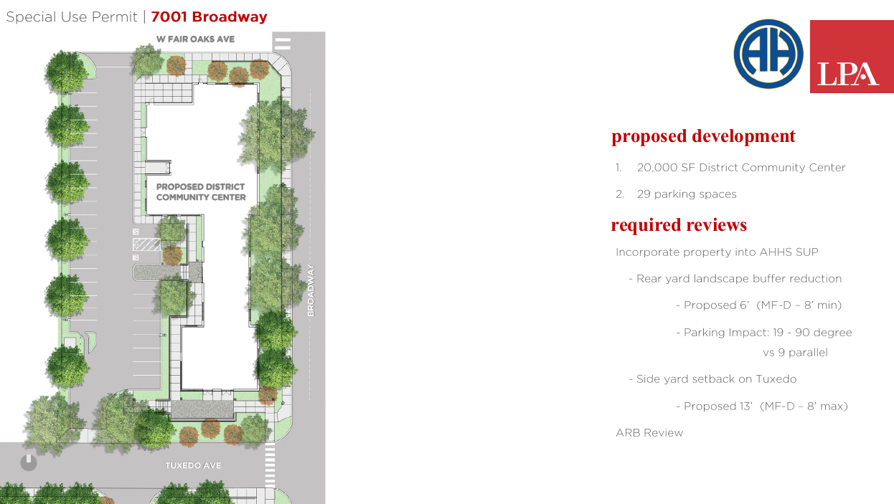
Proposal – District community center

Slide 42
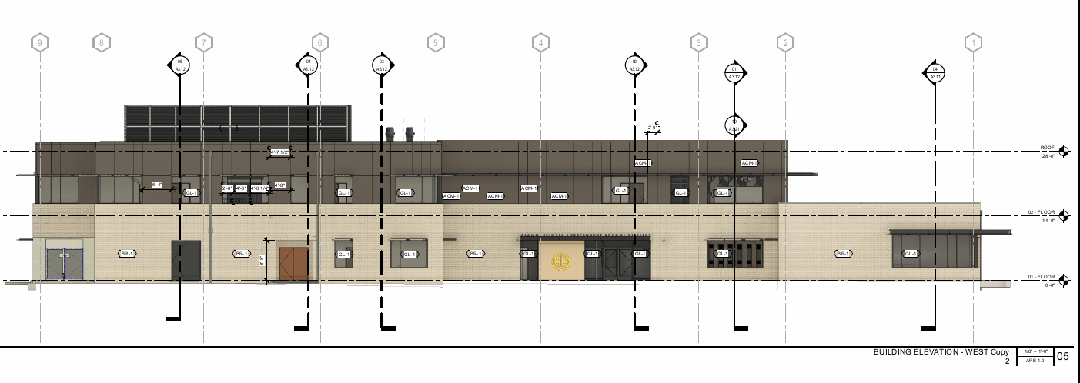
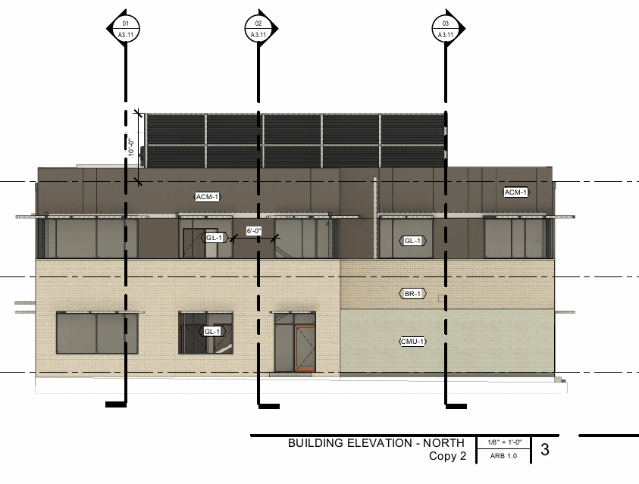
Proposal – District community center

Slide 43
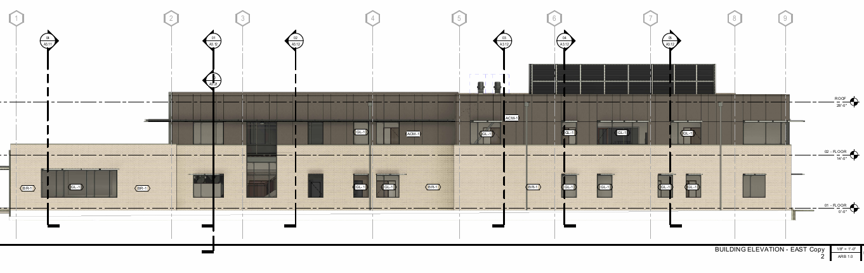
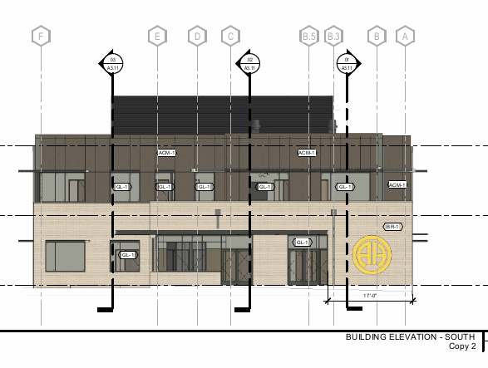
Proposal – District community center

Slide 44
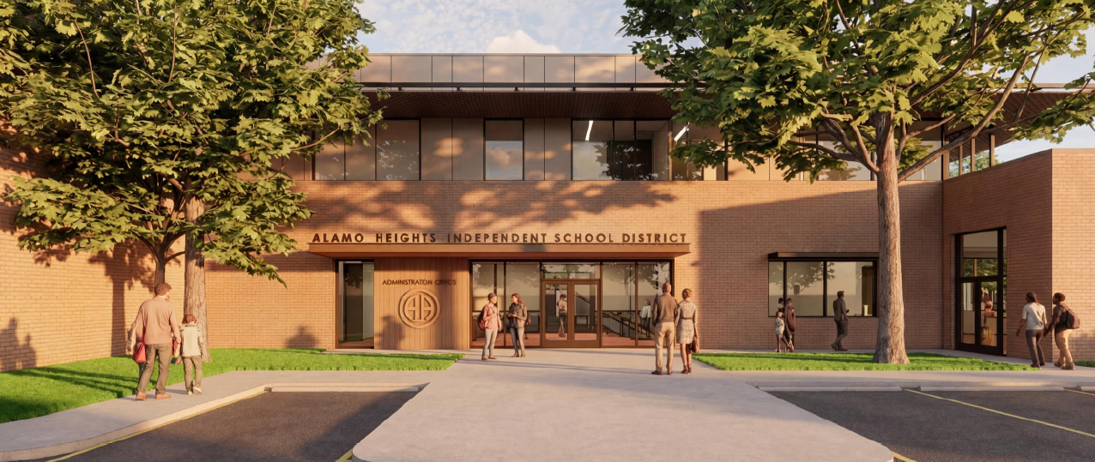
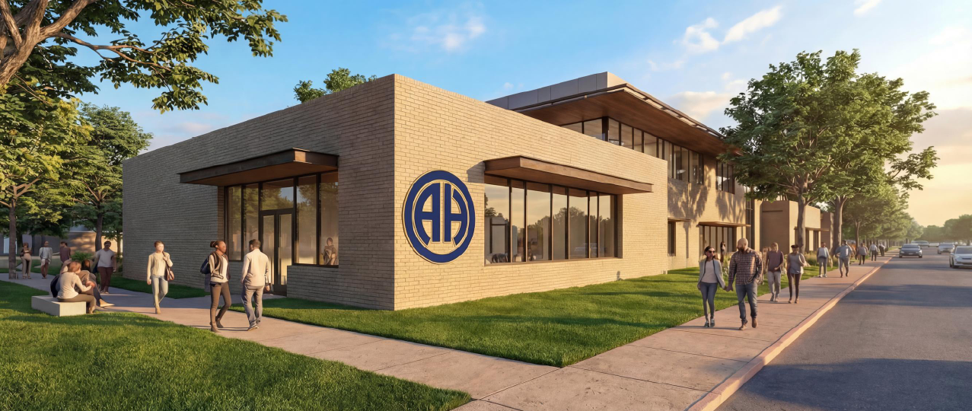
Proposal – District community center

Slide 45
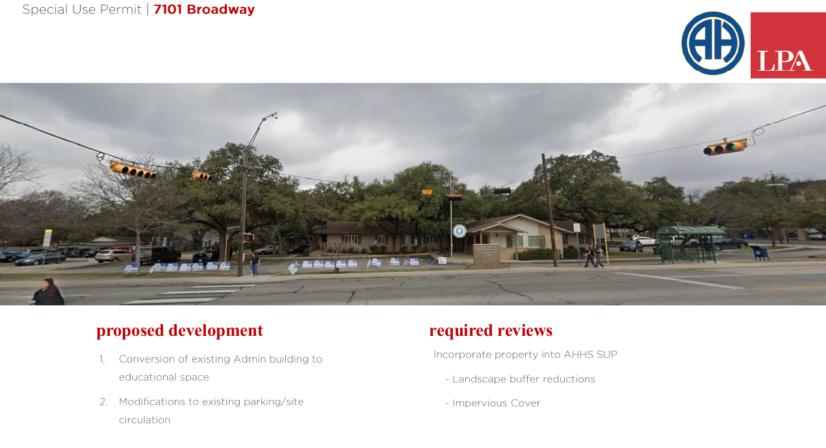
Proposal – 7101 Broadway St

Slide 46
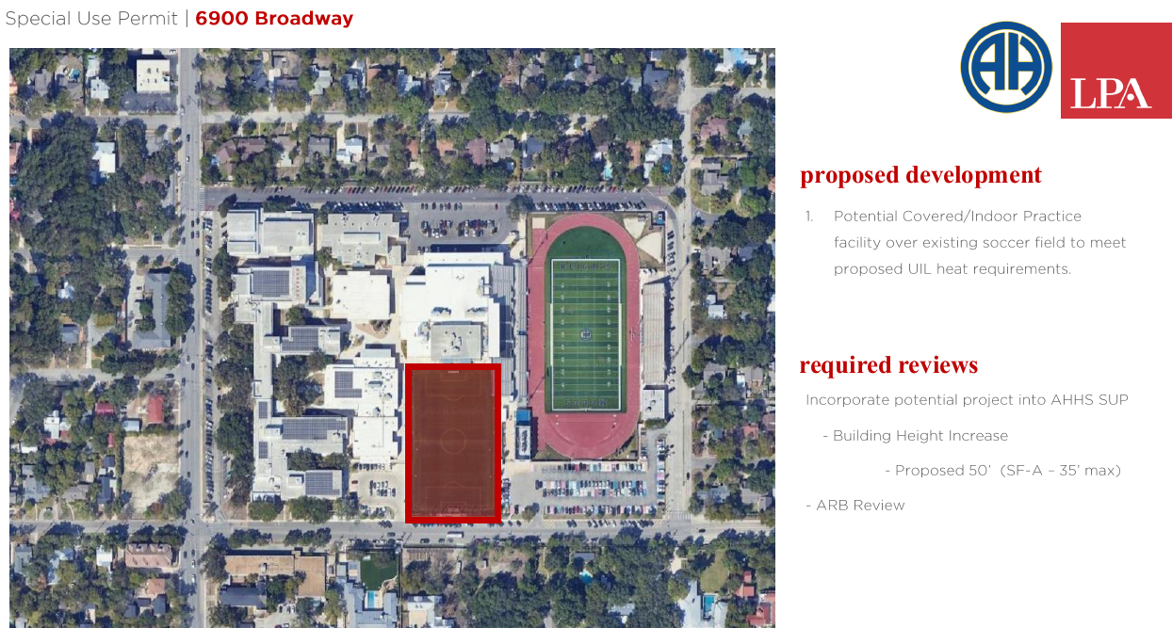
Proposal – 6900 broadway st (high school campus)

Slide 47
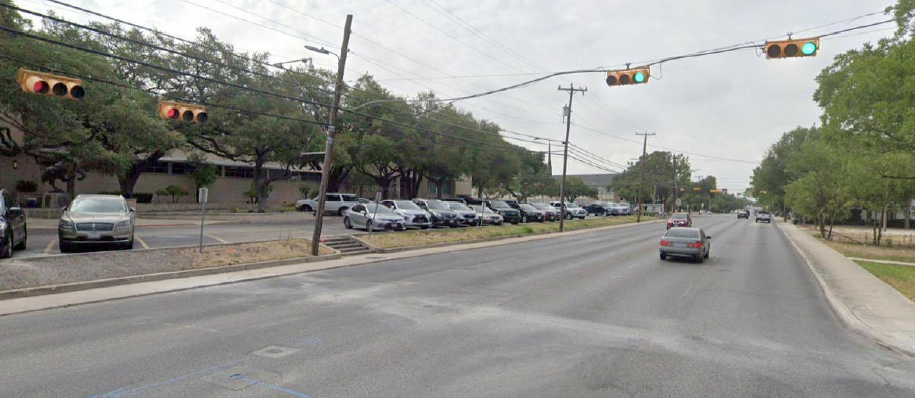
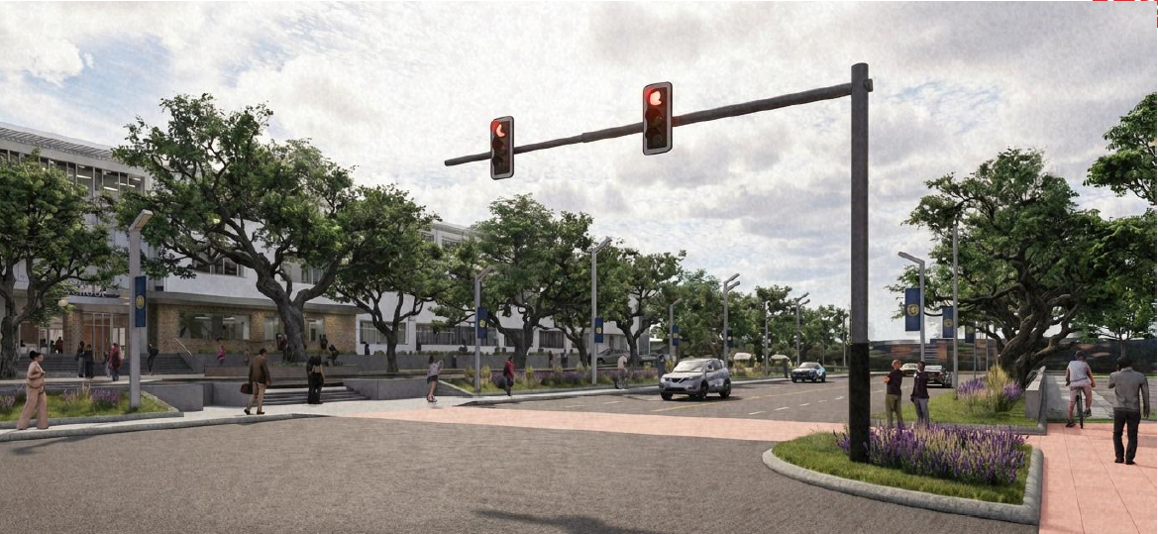
Public realm improvements

Slide 48
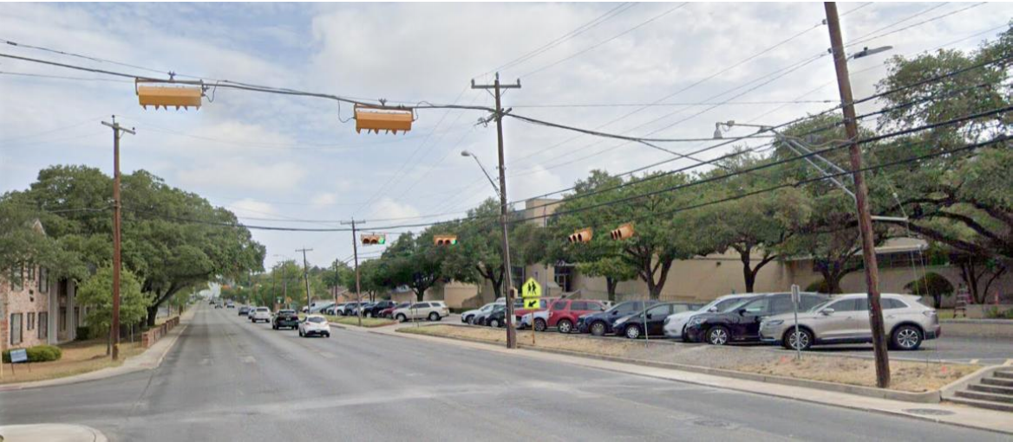
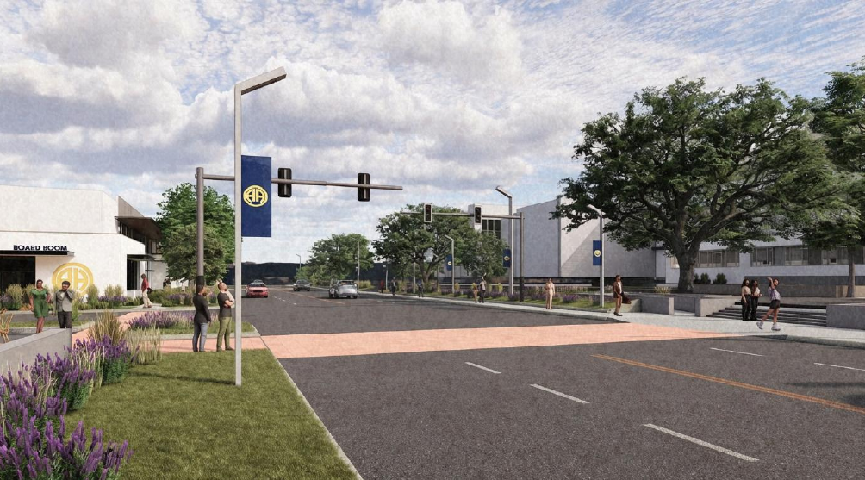
Public realm improvements

Slide 49
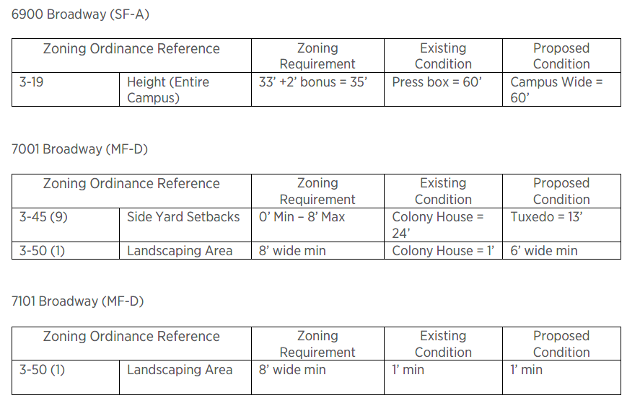
Variance requests

Slide 50
Policy analysis
Discussion/Feedback Only
Bring back SUP for action at next P&Z meeting

Slide 51
Public notification
Postcards – mailed to property owners within a 200-foot radius
Notices – posted on City website and on the properties
Legal Notice – posted in official newspaper of the City (SA Express News)
Responses received (Inside 200-ft radius):
Support: (0) Opposed: (0) Neutral: (0)
Responses received (Outside 200-ft radius):
Support: (0) Opposed: (0) Neutral: (0)

